Slide 1





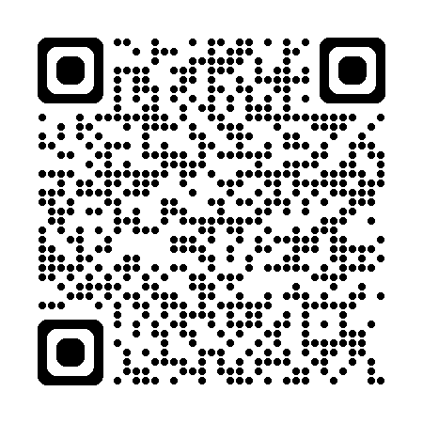
UK NEQAS H&I Annual Participant’s Meeting 2025-26
Notes:
Welcome
Fire exits/ no scheduled alarms
Toilets
Wi-fi access
Lunch – hot and cold buffet in the restaurant
Vegetarian, Halal, Vegan options but if you have specific food allergies let us know

Slide 2
Key Data from the Schemes Amy De’Ath UK NEQAS for H&I Manager
Notes:
I am going to cover key data from the crossmatching and HLA and HPA antibody schemes from 2025-26 and some relevant updates for the upcoming distribution year.
Director Deborah Pritchard will be continuing this scheme overview covering HLA, HPA and KIR typing as well as DA schemes.

Slide 3


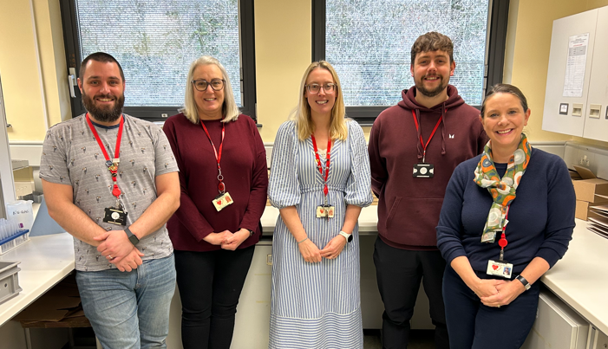
Meet The Team!
Director: Deborah Pritchard
Manager: Amy De’Ath
Deputy Manager: Melanie Bartley
Healthcare Scientist Practitioner: Geraint Clarke
QA Technical Officer: Jack Jefferies
MLA: Sue Davies

Slide 4

UK NEQAS for H&I Steering Committee 2025-26
Helena Lee (Chair)
Arthi Anand
Katy Derbyshire
Sylvia McConnell
Katherine Mounsey
Anthony Calvert
Sunil Daga (Clinical Representative)
Fotini Partheniou (BSHI Representative)
Rhys Goodhead (Expert Advisor Scheme 5B)
Barbara McNamara (Expert Advisor Scheme 5B)
Tim Clench (Expert Advisor Scheme 5B)
Notes:
Experts in different areas of H&I, advise on scheme design, assess appeals, assist with educational remit of the service by providing iED scenarios and attending webinars.

Slide 5
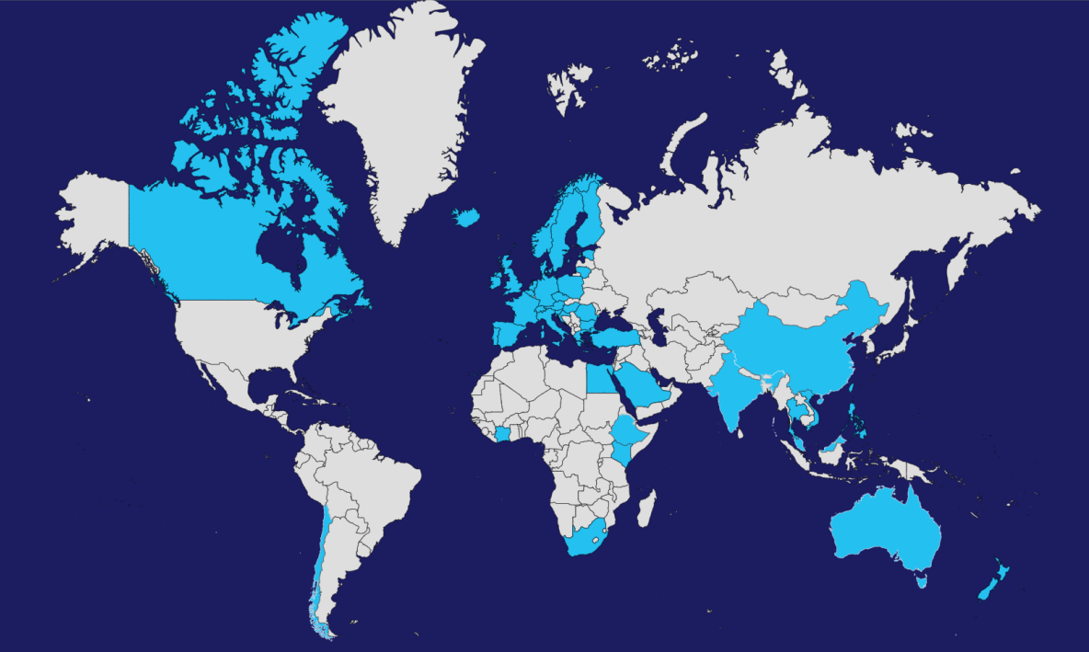
UK NEQAS for H&I: An Overview
>320 participants
>50 countries
Notes:
We have over 320 participant laboratories in more than 50 countries. Today we will you data from all areas but we will focus on UK&I performance.

Slide 6
Things To Note…
Presentation Focus…
Further Details…
Performance, key trends, discussion points and 2026 changes
The presentation will be available to view on our website.
Lab Locations…
Generally: 1-100 = UK & Ireland. 101+ = Rest of the world
Notes:
*The presentation will focus on performance within each scheme, highlight any key trends or interesting findings.
It will be available on our website.
*In terms of the lab numbers you will see throughout the presentation, as a guide generally numbers 1-100 are UK&I based whereas >100 are RoW based.

Slide 7
Scheme Assessments
Most Schemes assessed on a consensus basis using a 75% consensus level i.e. 75% of reports must agree on a result for it to be assessed.
Reference typing results are used for disease association and drug hypersensitivity schemes or in some schemes if consensus not reached
e.g. Scheme 8: HLA Genotyping for Coeliac and Other HLA Associated Diseases
Equivocal result only accepted for Scheme 2B.
All Not Tested (NT) results excluded from assessment.
Labs that fail to return results or do not a provide valid reason for NT are assessed as unacceptable.
Notes:
Most of our schemes are assessed using a consensus basis requiring 75% labs agreeing a result.
Reference results are used for some typing and disease association schemes such as Scheme 8 Reporting of equivocal results is only accepted for assessment in Scheme 2B.
Results submitted as Not Tested are excluded from assessment.
Labs are assessed as unacceptable if they fail to return results or give a valid reason why they did not report results.

Slide 8
Unsatisfactory Performance (UP)
Each scheme has minimum annual performance criteria:
HLA Typing schemes 90%
Crossmatching 85%
Disease Association Schemes 100%
Antibody Specificity 75%
Antibody Detection 80%
Participants that do not meet the minimum criteria are classed as unsatisfactory performers.
Must complete a root cause analysis and CAPA form.
Notes:
Lab are assessed as satisfactory if they report in line with consensus or reference result.
Minimum performance criteria must be met e.g. in Typing schemes generally 90% of results must be correct
Participants that do not meet these thresholds are classed as UPs and are asked to complete a RCA and CAPA form.

Slide 9
Changes for 2026-27
Schemes
Portal
Scheme 5A – result deadline extended
Scheme 10 – HPA-9 added
Scheme 12 – HNA Genotyping
Scheme 13 – HNA Antibody Detection
New Participant
Portal
Pilot Scheme
Sustainability
Interpretative comments for Coeliac Disease
Paperless: no distribution slips
Packaging: reduce plastic
Notes:
In terms of changes for 2025-26
Pilots Schemes – continuing interpretative scheme for CD comments
After a successful pilot Scheme 12 and 13 have been transitioned to fully assessed schemes
Sustainability – initial trial of paperless send outs successful so will be continued
Most notable change is the launch of our new IT system

Slide 10

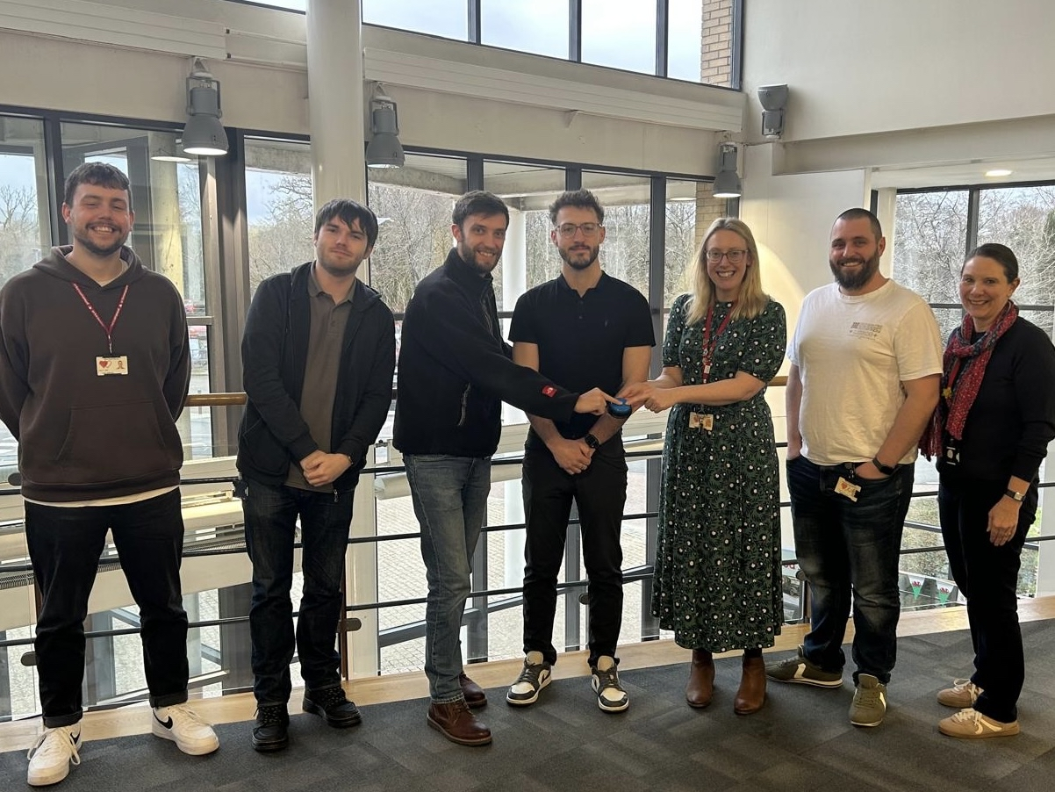
New Participant Portal
New System
Old System
End of life
Increased security
Commercial system – expensive to buy and run
Easier to use, Microsoft based
Expensive to develop functionality
Increased functionality and management
Notes:
The old Portal which had been in use since 2019 was at the end of its life and the contract to support it ended. Commercially developed systems were extremely expensive to purchase and maintain therefore a decision was made to develop our own software in-house. Our Trust Digital team have worked extremely hard to help us deliver a new system which offers greater security (if you have logged on you will have noted the new authentication process). We hope the new system will be easier to use as it is Microsoft based. You will see this system grow and new functionality being added over the upcoming months. Our plans are that this will include a live dashboard on your laboratory accounts to allow you to easily see when samples and results are due and track your performance. We welcome any feedback you have so please get in contact.

Slide 11
2A
Cytotoxic Crossmatching
Scheme
Notes:
Now on to feedback from our crossmatching schemes beginning with Scheme 2A – Cytotoxic crossmatching

Slide 12
Scheme 2A – Cytotoxic Crossmatch
Purpose
Assess participants ability to determine cell/serum cytotoxicity crossmatch status
Consensus
At least 75% agreement on pos/neg result
Satisfactory Performance
85% of reports agree with consensus in distribution year for each cell/DTT type
10 blood samples, 40 serum samples over 5 distributions
Notes:
The purpose…
Consensus…
Satisfactory performance is…

Slide 13
Scheme 2A: Performance
All cells with and without DTT | 2019 | 2020 | 2021 | 2022 | 2023 | 2024 | 2025
Number of Participants (UK&I) | 71 (22) | 66 (16) | 63 (15) | 59 (15) | 47 (10) | 47 (8) | 45 (8)
Number with Unsatisfactory Performance (< 85%) (UK&I) | 5 (1) | 7 (0) | 4 (0) | 6 (3) | 2 (2) | 5 (0) | 5 (0)
% Unsatisfactory Performance (UK&I) | 7.0% (4.5%) | 10.6% (0) | 6.3% (0) | 10.2% (20%) | 4.2% (20%) | 10.8% (0%) | 11.1% (0%)
2025: 5 Unsatisfactory Performers (0 UK & Ireland)
Notes:
Explain table…
Deceasing number of participants after predominantly UK labs drop CDCXM and many European labs starting to follow
Of the 45 participants 5 (11.1%) of them had UP, none of them UK or Ireland based

Slide 14
Scheme 2A: Performance by category
 | PBL | PBL +DTT | T Cell | T Cell +DTT | B Cell | B Cell +DTT
Crossmatches assessed (n=40) (UK&I) | 35 (35) | 36 (36) | 38 (39) | 38 (39) | 32 (28) | 35 (34)
NT – Assessed samples only | 10.4% | 13.4% | 8.9% | 8.1% | 14.6% | 12.3%
% incorrect assignments | 3.6% | 3.6% | 2.8% | 2.1% | 4.8% | 3.8%
False Positive | 2.3% | 2.8% | 1.7% | 1.5% | 2.4% | 2.0%
False Negative | 1.3% | 0.8% | 1.1% | 0.6% | 2.4% | 1.8%
Notes:
There are a number of categories * available in 2A and participants can choose to be registered for assessment at B cell, T cell or PBL with and without the addition of DTT.
40 possible crossmatch combinations per year
Worldwide generally over >35/40 XMs are assessed in each category. We do see that B cell XM * has the lowest level of assessed XM which is comparable to previous years
The amount of samples reported as NT is highest for B cell at approx. 12-14% whereas T cell is around 8% NT this could be due to the more fragile nature of B cells
incorrect assignments mostly occur at B cells but is lowest in T cells
Across all categories more likely to report false pos results, false pos reporting is highest in PBLs and lowest in T cells
False neg reporting is highest in B cells but lowest in T cells

Slide 15
Scheme 2A: Unacceptable Performers 2025
Lab ID | PBL -DTT | T -DTT | B -DTT | PBL + DTT | T + DTT | B + DTT | Lab Identified Error
147 |  |  |  |  |  | 79% | No response
189 | 81% |  |  |  |  |  | Technical issue– new controls implemented
232 |  |  | 76% |  |  | 72% | Sample delivery delay - poor cell prep
1399 |  |  | 82% |  |  |  | Human error - report mix up & technical interpretation
1412 |  | 56% | 36% |  |  |  | No response
Notes:
5 UP – red in category denotes PP: 1 in T cell and B cell, 1 in PBL only, 3 in B cell only. Greater level of performance issues without DTT.
CAPA responses included delivery delays and poor cell quality and human error.

Slide 16
Scheme 2A: Discussion
Not all Scheme 2A results expected to reach consensus
B-cells are difficult (transport, non-specific binding)
Only partially emulates clinical practice
2A is a technical assessment of cytotoxic crossmatching and should not be ‘interpreted’
Lab’s need to ensure that all test parameters and acceptance criteria are met prior to reporting NEQAS samples
CDC assays are not quantitative so reliant on subjective assessment

Slide 17
2B
Crossmatching by Flow Cytometry
Scheme
Notes:
Now on to our flow crossmatching scheme, 2B

Slide 18
Scheme 2B: Crossmatching by Flow Cytometry
Purpose
Assess participants ability to determine cell/serum flow crossmatch status
Consensus
At least 75% agreement on pos/neg or equivocal result
Satisfactory Performance
85% reports agree with consensus in distribution year for each cell type
10 blood samples, 40 serum samples over 5 distributions
Notes:
The purpose
Consensus
Sat Perf

Slide 19
Scheme 2B: Performance
 | 2019 | 2020 | 2021 | 2022 | 2023 | 2024 | 2025
Number of Participants (UK&I) | 84 (23) | 80 (21) | 80 (22) | 84 (19) | 83 (21) | 79 (20) | 75 (20)
Number with Unsatisfactory Performance (< 85%) (UK&I) | 12 (1) | 11 (0) | 5 (0) | 6 (2) | 10 (0) | 4 (0) | 4 (1)
% Unsatisfactory Performance (UK&I) | 14.2% (4.3%) | 13.8% (0) | 6.3% (0) | 7.1% (10.5%) | 12% (0) | 5% (0) | 5.3% (5%)
2025: 4 Unsatisfactory Performers (1 UK & Ireland)
Notes:
Slight reduction in the number of participants, currently at 75.
4 participants with UP: 1 based in UK&I.

Slide 20
Scheme 2B: Performance by Category
 | T Cells |  |  |  | B Cells
 | UK&I | RoW PC | RoW WB |  | UK&I | RoW PC | RoW WB
Number of participants | 20 | 25 | 30 |  | 20 | 25 | 28
Number of XM assessed (>75% consensus) | 34/40 (85%) | 32/40 (80%) | 38/40 (95%) |  | 35/40 (87.5%) | 33/40 (82.5%) | 35/40 (87.5%)
Number of Positive XM | 16 (47%) | 12 (31%) | 17 (45%) |  | 24 (69%) | 21 (64%) | 23 (66%)
Number of Negative XM | 18 (53%) | 20 (63%) | 21 (55%) |  | 11 (31%) | 12 (36%) | 12 (34%)
Number of incorrect assignments | 12 | 18 | 39 |  | 31 | 36 | 55
Number of False Pos | 6 | 6 | 9 |  | 16 | 9 | 10
Number of False Neg | 6 | 9 | 25 |  | 15 | 23 | 41
Number of equivocal assignments | 0 | 3 | 5 |  | 0 | 4 | 4
Number of samples NT | 27 | 86 | 39 |  | 65 | 95 | 40
UK&I and RoW receive different blood samples
Notes:
Categories for T and B cells
Split into groups get different samples.
40 crossmatch combinations - a high proportion, generally approx. >80% assessed across all categories.
There was a good representation of positive versus negative crossmatches found across all categories.
Fairly even spread of incorrect assignments : highest in ROW WB in T and B cells categories
Higher incidence of reporting false positives and false negative in B cell XM
very few instances of reporting equivocal results and none in the UK&I
Reporting results as NT highest in PC labs – could be due to cell viability issues as these samples often travel the furthest.

Slide 21
Scheme 2B: Unacceptable Performers 2025
Lab | T Cell | No. of results submitted | B Cell | No. of results submitted | Issue
23 | 94% | 40/40 | 81% | 40/40 | Sensitivity issues/cut off values
139 | 94% | 40/40 | 72% | 39/40 | No response
142 | 88% | 40/40 | 83% | 40/40 | To review cut off values
1463 | 89% | 32/40 | 76% | 32/40 | Sensitivity issue (delivery delays/poor cell prep)
4 labs with UP (<85%)
Notes:
4 participants classed as UP all in the B cell category
All had reported results for at least 30 XMs
3 submitted CAPA: all had sensitivity issues and whilst 2 labs wanted to review cut off values the other lab cited cell quality issues

Slide 22
6
HLA Antibody Detection
Scheme
Notes:
On to our HLA antibody detection scheme now – Scheme 6

Slide 23
Scheme 6: HLA Antibody Detection
Purpose
Assess participants ability to determine presence or absence of HLA antibodies
Consensus
At least 75% agreement on presence/absence of HLA antibodies
Satisfactory Performance
80% reports agree with consensus in distribution year
12 serum samples over 3 distributions
Notes:
Purpose
Consensus
Sat Performance

Slide 24
Scheme 6: Performance
8 Unsatisfactory Performers (6 UK&I)
 | 2019 | 2020 | 2021 | 2022 | 2023 | 2024 | 2025
Number of Participants (UK&I) | 82 (25) | 74 (25) | 71 (23) | 68 (23) | 68 (23) | 67 (24) | 62 (22)
Number with Unsatisfactory Performance (< 80%) (UK&I) | 8 (0) | 2 (0) | 0 (0) | 4 (0) | 3 (0) | 3 (1) | 8 (6)
% Unsatisfactory Performance | 9.7% (0%) | 2.7% (0%) | 0% (0%) | 5% (0%) | 4.4% (0) | 4.4% (4.1%) | 13% (27%)
63% negative
29% positive
8% samples not assessed
Notes:
Reduction in participants in the last year as some labs report using only SAB in their antibody detection strategy
8 labs with PP, 6 of these based in UK&I.
Analysis of the samples sent showed that 63% were consensus negative, 29% positive and 8% did not reach a consensus so the non-assessment of samples was not a factor in the numbers of UPs.

Slide 25
Scheme 6: Unacceptable Performers 2025
Lab | Performance (<80%) | Issue | CAPA
14 | 75% | False Pos CI and CII | Kit / bead reactivity
20 | 50% | False Pos CI and CII | Interpretation (pos cut off)
25 | 67% | False Pos CI and CII | Interpretation (pos cut off)
35 | 58% | False Pos/Neg CI and CII | Reagent / testing issues
45 | 75% | False Pos CI | Sensitivity issues
48 | 75% | False Pos CI and CII | Sensitivity issues
189 | 75% | False Pos/Neg CII | Interpretation / cut off values
1418 | 25% | False Pos CI and CII | Interpretation / kit issue
8 labs with UP (<85%)
Notes:
8 participants classed as UP, 6 from UK&I
8 CAPA responses submitted
1 noting a kit reactivity issue, 1 a reagent/testing issue
And many cited that this UP was a known effect as their pos cut off for ab detection favours false pos, responses from UK labs often stated that their strategy had a preference for false positives that they were aware of and accepted.

Slide 26
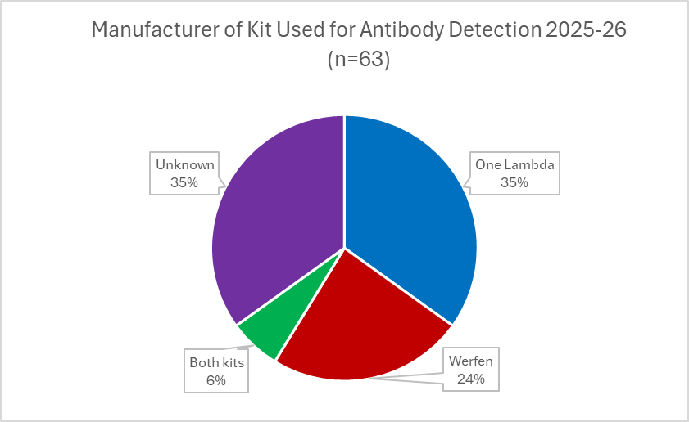
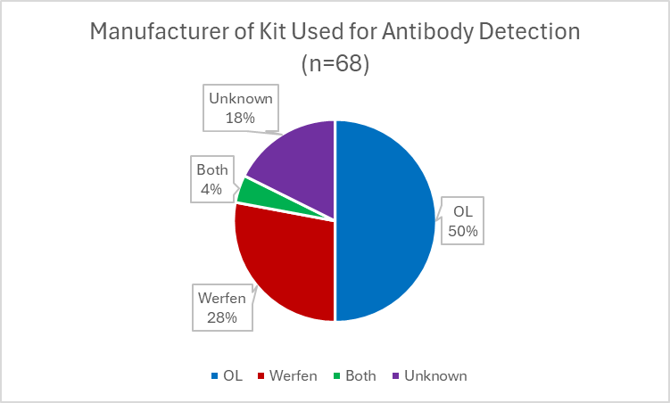
Scheme 6: Kit Use
Notes:
Every year we perform an analysis of scheme 6 methodology and performance.
As you can see from the chart approx. 35% use One lambda for antibody detection, 24% Werfen kits, 6% Both and 35% did not report their methodology – I have included the graph from last year for comparison where more labs reported their methodology data and you can seem half used OL kits

Slide 27
Scheme 6: Kit Use and Performance
Notes:
We also performed an investigation of kit use affects consensus result (noting that we only included information from labs that used OL, Werfen or both kits and excluded those that did not report methods)
The table shows the consensus result * and the result split by method for class I and then class II
Results generally concur across the samples exceptions are
602 in Class I Pos by OL and Both but no cons in werfen users.
605 there was no cons overall in Class II or amongst OL only user but those that used both were cons neg and those that use werfen were pos
609 in class I there was no cons in OL or both users but neg in werfen
612 there was no cons overall in Class II or amongst OL only user but those that used both were cons pos and those that use werfen were neg
Interestingly in sample 604, 608 and 611 there are examples were OL and Werfen user agreed cons neg but those using both kits did not reach cons (noting the small sample numbers in the category of user)

Slide 28
3
HLA Antibody Specificity Analysis
Scheme
Notes:
Our sister HLA antibody scheme – Scheme 3 is next

Slide 29
Scheme 3: HLA Antibody Specificity Analysis
Purpose
Assess participants ability to determine specificity of HLA antibodies
Consensus
At least 75% agreement on presence of HLA antibodies, 95% agreement on absense.
Satisfactory Performance
75% reports agree with consensus in distribution year
10 serum samples over 3 distributions
Notes:
Purpose
Consensus
Sat performance

Slide 30
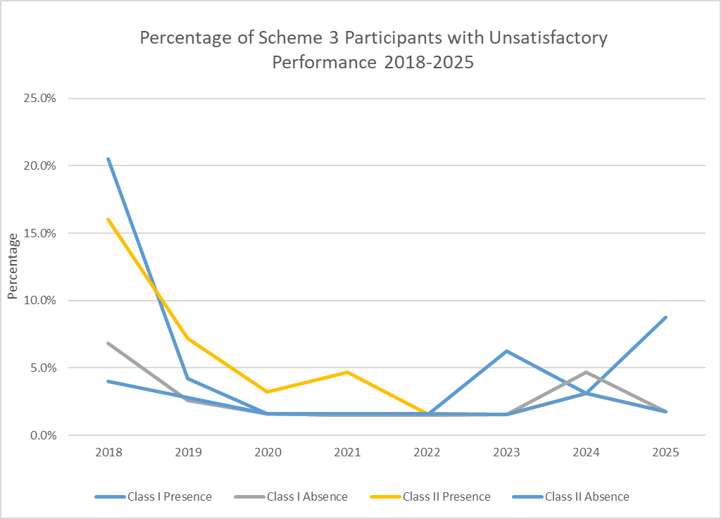
Scheme 3: Performance
Class I |  | 2019 | 2020 | 2021 | 2022 | 2023 | 2024 | 2025
Number of Participants (UK&I) |  | 70 (25) | 64 (24) | 65 (24) | 65 (24) | 64 (24) | 63 (23) | 58 (23)
Number with Unsatisfactory Performance (UK&I) | Presence | 3 (0) | 1 (0) | 1 (0) | 1 (0) | 4 (0) | 2 (0) | 5 (1)
 | Absence | 2 (0) | 1 (0) | 1 (0) | 1 (0) | 1 (0) | 3 (0) | 1 (0)
% Unsatisfactory Performance | Presence | 4.2% | 1.6% | 1.5% | 1.5% | 6.3% | 3.2% | 8.6%
 | Absence | 2.6% | 1.6% | 1.5% | 1.5% | 1.5% | 4.8% | 1.7%
Class II |  | 2019 | 2020 | 2021 | 2022 | 2023 | 2024 | 2025
Number of Participants (UK&I) |  | 69 (25) | 63 (24) | 64 (24) | 64 (24) | 64 (24) | 63 (23) | 58 (23)
Number with Unsatisfactory Performance (UK&I) | Presence | 5 (0) | 2 (0) | 3 (0) | 1 (0) | 1 (0) | 2 (0) | 1 (0)
 | Absence | 2 (0) | 1 (0) | 1 (0) | 1 (0) | 1 (0) | 2 (0) | 2 (0)
% Unsatisfactory Performance | Presence | 7.2% | 3.2% | 4.7% | 1.6% | 1.6% | 3.2% | 1.7%
 | Absence | 2.8% | 1.6% | 1.6% | 1.6% | 1.6% | 3.2% | 3.4%
Overall: 6 labs with UP (2 UK&I)
Notes:
register for assessment at Class I only or Class I&II.
split present (75% consensus) or absent (95%)
Overall - 6 labs with UP from the 63 participants, with issues noted in both the presence and absence category

Slide 31
Scheme 3: Unacceptable Performers 2025
6 labs (2 UK&I) with UP (<75% )
 | Class I |  | Class II |  | CAPA | Kit
Lab | Presence | Absence | Presence | Absence
15 | 67% |  |  |  | Clerical reporting error | One Lambda
35 | 74% |  |  |  | Analyser issues & testing strategy | One Lambda
112 | 73% |  |  |  | Only use one kit for testing | Werfen
302 |  | 69% | 51% | 56% | No response | One Lambda
361 | 68% |  |  |  | Only use one kit for testing | Werfen
1412 | 40% |  |  |  | No response | Werfen
Notes:
PP = missed reporting a consensus specificity or assigned a specificity where the consensus is negative resulting in <75% specs in agreement with consensus.
6 UP
Most had issues in CI presence categories.
1 had issues in both CI and CII.
Only 4 responded to requests for a CAPA investigation citing reporting errors, technical issues, and that testing strategy was based on one kit.

Slide 32
Scheme 3: Class I Assessment
 | Number of HLA Class I Specificities (n=63)
 | 301 | 302 | 303 | 304 | 305 | 306 | 307 | 308 | 309 | 310 | Total
Present (≥75%) | 4 | 9 | 42 | 20 | 2 | 44 | 11 | 12 | 2 | 25 | 171
Absent (<5%) | 9 | 31 | 16 | 30 | 8 | 16 | 11 | 62 | 5 | 31 | 219
Negative 0% | 66 | 43 | 10 | 27 | 75 | 19 | 63 | 12 | 81 | 3 | 405
Not Assessed (5-74%) | 10 | 6 | 21 | 12 | 4 | 10 | 4 | 3 | 1 | 30 | 101
491 (absent 0% not included in analysis) specificities reported over 10 samples
34.8% reached consensus presence
44.6% reached consensus absence
20.6% specificities were not assessed

Slide 33
Scheme 3: Class II Assessment
(DPB included in assessment from 2021)
 | Number of HLA Class II Specificities (DR, DQ, DP) (n=63)
 | 301 | 302 | 303 | 304 | 305 | 306 | 307 | 308 | 309 | 310 | Total
Present (≥75%) | 6 | 0 | 18 | 11 | 0 | 0 | 4 | 18 | 0 | 10 | 67
Absent (<5%) | 6 | 2 | 5 | 6 | 7 | 5 | 7 | 10 | 8 | 15 | 71
Negative 0% | 28 | 40 | 22 | 27 | 36 | 41 | 35 | 11 | 31 | 19 | 290
Not Assessed (5-74%) | 6 | 4 | 1 | 2 | 3 | 0 | 0 | 7 | 7 | 2 | 32
170 specificities (absent 0% not included in analysis) reported over 10 samples
39.4% reached consensus presence
41.8% reached consensus absence
18.8% specificities were not assessed

Slide 34
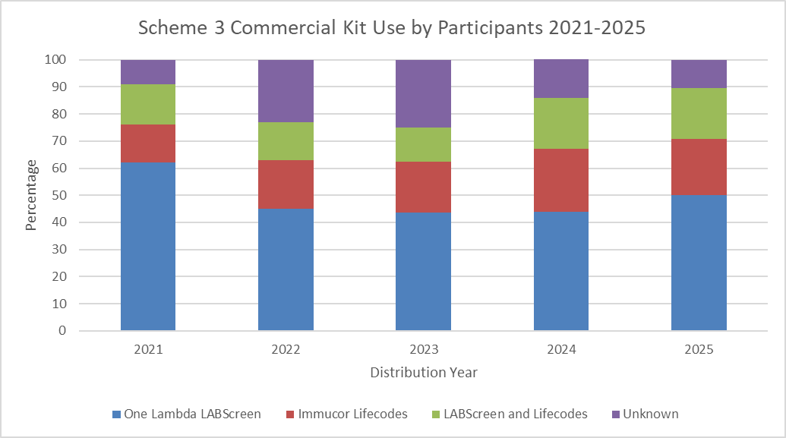
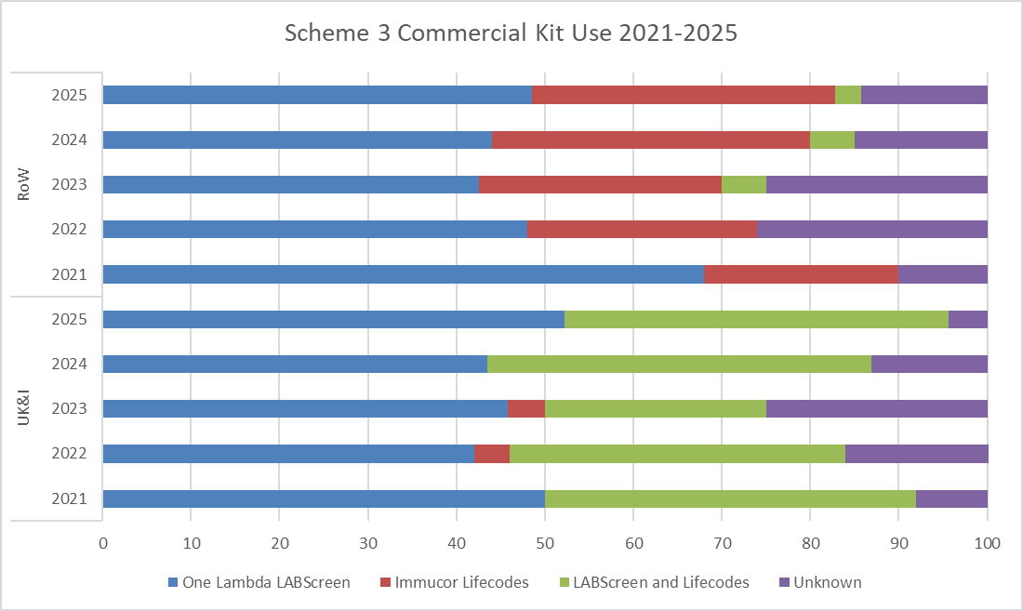
Scheme 3: Kit Use 2021-2025
Overall OL kits are the most widely used
UK&I labs are more likely to use a combination of kits
Werfen only kit use more prevalent in RoW labs
Notes:
We performed some analysis of kit use in Scheme 3 over 5 years.
Including all participants you can see that labs not accurately recording methods data (purple section) has impacted the picture but generally there seems to be slightly more labs opting to use both kits over time
OL is blue, Immucor is red, combo of kits is green and purple is unknown
* On this second graph the data is split into * RoW and UK&I * labs again over the past 5 years.
Historically in the UK OL were most widely used but now a combination of both kits is just as common
Werfen only use more prevalent in RoW labs with very few labs using both kits
Info may not represent the true lab testing strategy for clinical samples as taken from EQA data.
This data shows a split between manufacturer use so hopefully less potential impact on consensus by any one manufacturer

Slide 35
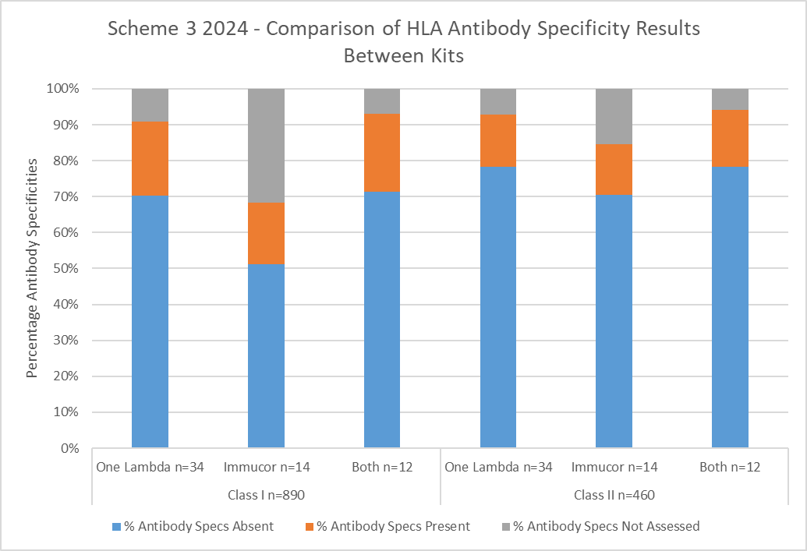
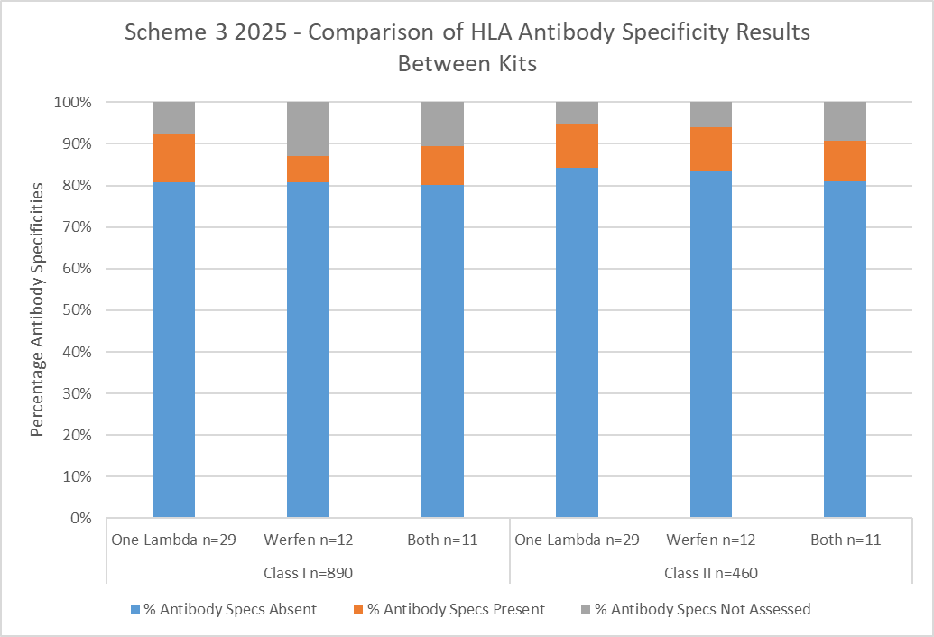
Scheme 3: Results by Kit Use
Similar percentage of antibodies reach consensus present (orange) in both kits
Slightly less concordance in ‘present’ CI antibodies
Marginally more antibodies classed as not assessed in Werfen group
Notes:
If we look at the result analysis by kit type
Number of CI * & CII * antibodies assessed split by kit: OL only, Werfen only and labs that use both kits
% specs classed as absent (blue), present (orange), NA (grey) across all 10 samples distributed in 2025-26
Showed a VERY similar percentage of antibodies reaching consensus ‘present’ (orange section) in both kits.
Slightly more CI antibodies * were classed as NA (grey) in the Werfen group could be due to sample size of group.
If we compare to last years data you can see there is much less variation between kit performance this year
"L:\AGM\2024-25\Scheme 3-2024 figures\OL v Imm 2024-2025 analysis for presentation.xlsx“

Slide 36
Scheme 3: Kit Use and Performance
Average overall satisfactory performance for detecting the ‘presence’ and ‘absence’ of antibodies:
Notes:
Split performance in the scheme by kit use across OL only, werfen only and both kit users: note the smaller sample size with werfen and both kit users which would have impacted analysis
Concordance detecting the ‘presence’ of antibodies highest amongst users of OL in CI and CII
Concordance detecting the ‘absence’ of antibodies highest amongst users of both kits in CI and across the board concordance for CII

Slide 37
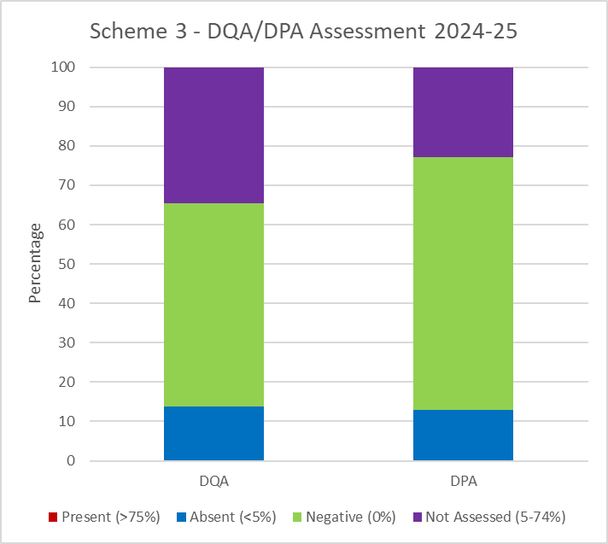
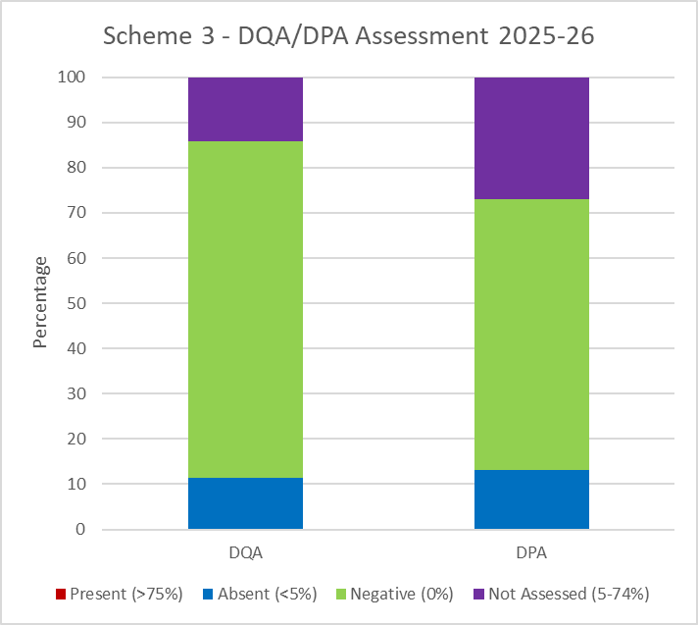
Scheme 3: DQA/DPA Antibody Reporting
Reporting of antibodies to HLA-DQA and –DPA is optional and not assessed.
Overall 44/60 (73%) report DQA, 38/60 (63%) report DPA
Previously 67% and 60%
An analysis of the data submitted for DQA and DPA antibodies in 2025-26 and 2024-25 was performed.
Large proportion of samples are negative or consensus absent.
No antibodies deemed positives.
Approx 15-30% not assessed, higher in DPA.
Notes:
Reporting of DQA and DPA is optional, over 60% reports specs – increase on last year
Majority of specs are reported as negative or absent shown in blue and green where 95% or more of participants report a negative.
No specs reached consensus positive this year
High portion of NA: over 20% for DPA and over 30% for DQA
Similar to last year when no positives were recorded

Slide 38
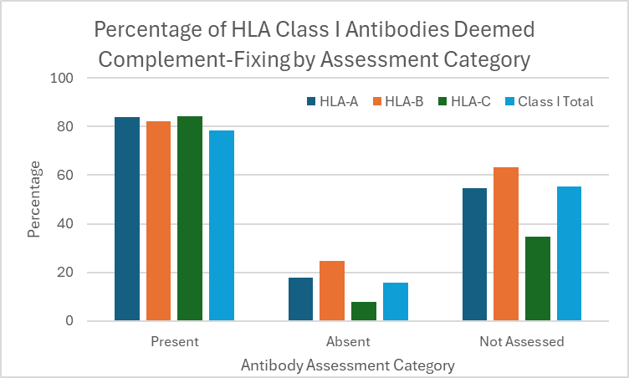
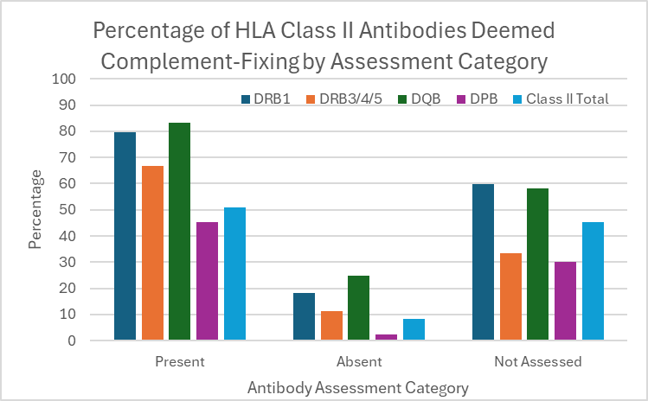
Scheme 3: Reporting Complement Fixing Antibodies
Option to report complement-fixing antibodies, but not formally assessed.
Max 22.9% (14/61) participants (6 UK&I) reported complement-fixing antibodies in at least one of the 10 samples in the 2024-25 distribution year.
The most frequent reporting of class I complement-fixing antibodies occurred at HLA-B>A>C
The most frequent reporting of class II complement-fixing antibodies occurred at HLA-DQB1>DRB3/4/5>DRB1>DPB
Notes:
Participants have the option to report complement-fixing antibodies but this is not formally assessed.
23% participants (6 UK & Ireland) reported complement-fixing antibodies in at least one of the 10 samples in the 2024-25 distribution year.
For class I in presence category 78.3% of which were reported as complement-fixing by >1 participant.
In absent category 15.8% were reported as complement-fixing.
In NA 55.3% were reported as complement-fixing, see Figure 1.
The most frequent reporting of class I complement-fixing antibodies occurred at HLA-B (38%)>A (34%)>C(28%)
For class II, in present category overall 51% were reported as complement-fixing
In absent 8.5% were reported as complement-fixing.
IN NA 45.5% were reported as complement-fixing.
The most frequent reporting of class II complement-fixing antibodies occurred at HLA-DQB1 (32%)>DRB3/4/5 (22%)>DRB1 (31%)>DPB (15%)
The UK NEQAS for H&I encourages laboratories to report complement-fixing antibodies in Scheme 3 if they have defined them in their testing strategy.

Slide 39
11
HPA Antibody Detection/Specification
Scheme
Notes:
Now we which to HPA antibodies in Scheme 11

Slide 40
Scheme 11: HPA Antibody Detection/Specification
Purpose
Assess participants ability to correctly determine pesence and specificty of HPA antibodies.
Consensus
Presence of specificity determined by at least 75% agreement and absence determined by at least 95% agreement.
Satisfactory Performance
At least 75% of specificities in agreement with the consensus result in a distribution year.
8 serum/plasma samples over 2 distributions
Notes:
Purpose
Consensus
Performance

Slide 41
Scheme 11: Performance
5 Unsatisfactory Performers (0 UK&I)
 | 2019 | 2020 | 2021 | 2022 | 2023 | 2024 | 2025
Number of Participants (UK&I) | 39 (5) | 42 (4) | 43 (4) | 43 (4) | 43 (4) | 44 (4) | 43 (4)
Number with Unsatisfactory Performance (< 75%) (UK&I) | 1 (0) | 3 (0) | 6 (0) | 2 (0) | 9 (0) | 1 (0) | 5 (0)
% Unsatisfactory Performance | 2.6% | 7.1% | 13.9% | 4.5% | 20.9% | 2.3% | 11.6%
Notes:
Stable number of participants since 2021
5 UPs

Slide 42
Scheme 11: HPA Antibody Detection/Specification
2025-26 Sample | HPA Detection | HLA Detection | Expected Result | HPA Antibody Consensus
 |  |  |  | Presence | Absence
1 | 87.5% Pos | 62.5% Neg | HPA-3a | HPA 3a 87.5% | HPA 4a 97.3%
2 | 100% Neg | 97.5% Neg | HPA neg, HLA neg | N/A | N/A
3 | 100% Pos | 100% Pos | HPA-5b, HLA pos | HPA 5b 100% | HPA GP1a/11a 95%
4 | 100% Neg | 97.5% Neg | HPA neg, HLA neg | N/A | N/A
5 | 97.6% Neg | 90% Neg | HPA neg, HLA neg | N/A | HPA 5b 97.6%
6 | 95.1% Pos | 100% Pos | HPA-1b 3b 5b | HPA 1b 95.1%, 3b 92.7%, 5b 97.6% | HPA 2b 97.4, 4b 97.2% GP1a/11a 97.5%
7 | 85.7% Pos | 50% Pos | HPA-5b, HLA pos | HPA 5b 85.7% | HPA 11a/11b 97.5% 1a/11a 95%
8 | 100% Neg | 100% Neg | HPA neg, HLA neg | N/A | N/A
Notes:
Most samples performed as expected eg sample 1, * we expected labs to define HPA-3a antibodies and 3a reached consensus present.
We sent 4 * samples with HPA ab – all 4 reached consensus present.
You will note that Sample 7 * was expected to have a HLA antibody but only 50% of labs reported it as HLA positive

Slide 43
Scheme 11: Unacceptable Performers 2025
Lab | HPA Presence | HPA Absence | Samples reported | Method | Error
180 | 67% | 100% | 8/8 | Werfen PakPlus | Sensitivity / resolution issue
199 | 67% | 88% | 8/8 | Werfen PakLx | Age of samples / sensitivity issues
281 | 100% | 63% | 8/8 | Werfen PakLx | Interpretation issue
387 | 50% | 100% | 8/8 | In house | No response
405 | 67% | 100% | 8/8 | Werfen PakLx | Staff shortage, result entry error
5 lab with UP (<75%)
Notes:
5 labs had UP in Scheme 11 mainly due to issues in HPA presence category (so they had missed an HPA antibody)
CAPA responses were received from 5 labs noting issues such as sensitivity in testing methods, interpretation issues and result entry issues.

Slide 44
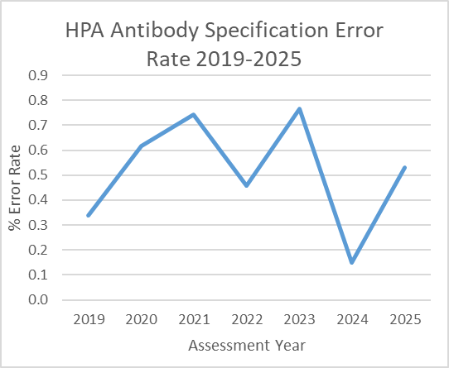
Scheme 11: Analysis of Errors 2025
Error rate extremely low (overall 0.53%) but errors often at
clinically relevant polymorphisms.
Errors found at HPA-1b (n=2, error rate 0.6%),
2b (n=1, error rate 0.3%), 3a (n=5, error rate 1.5%), 3b (n=3, error rate 0.9%), 4a (n=1, error rate 0.3%), 5b (n=1, error rate 0.3%) and some glycoproteins.
False negative (n=17) more common than false positive (n=10) errors.
Most labs had only 1 error
Notes:
We performed an analysis of errors made in Scheme 11
error rate 0.53% in range with previous years (shown in graph)
But errors are often at clinically relevant polymorphisms such as * 5b.
false negatives are more common than false positive errors
Labs only had 1 error but some had 2 or 3

Slide 45
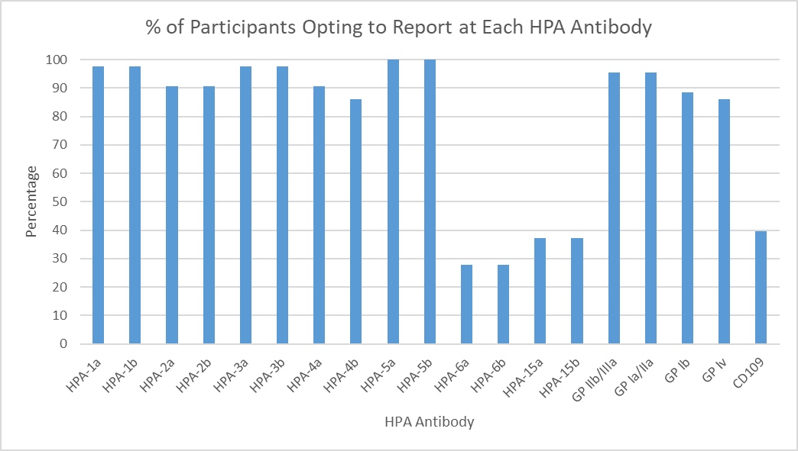
Scheme 11: Selection of HPA Antibodies for Assessment
Originally introduced in 2024-25
Labs can select any/all HPA antibodies for assessment based on their clinical strategy
Notes:
From 2024 the scheme has been modified to allow participants to register for only the HPA antibodies that they are able to detect relevant to their clinical strategy.
Majority of labs opt to report antibodies at HPA 1-5 but only approx. 30-40% report HPA-6 and -15.

Slide 46
Thanks!
Do you have any questions?
UKNEQASHandI@Wales.NHS.UK
+44(0)1443 622185
www.ukneqashandi.org.uk

Slide 47

Key Data from the Schemes Deborah Pritchard UK NEQAS for H&I Director

Slide 48
1A
HLA Phenotyping
Scheme
Notes:
HLA Phenotyping

Slide 49
Scheme 1A: HLA Phenotyping
Purpose
Assess participants ability to use serological and supplementary methods to correctly identify HLA phenotype
Consensus
At least 75% agreement on each specificity.
Satisfactory Performance
9 or more complete HLA phenotypes in agreement with consensus per distribution year.
10 blood samples over 5 distributions

Slide 50

Scheme 1A: Performance
2 labs with unsatisfactory performance
 | 2019 | 2020 | 2021 | 2022 | 2023 | 2024 | 2025
Number of Participants (UK&I) | 38 (5) | 34 (4) | 33 (2) | 28 (1) | 23 (0) | 19 (0) | 14 (0)
Number with Unsatisfactory Performance (< 90%) (UK&I) | 8 (1) | 3 (1) | 2 (0) | 2 (0) | 2 (0) | 0 (0) | 2 (0)
% Unsatisfactory Performance | 21.1% | 8.8% | 6.1% | 7.1% | 8.7% | 0% | 14.3%
Notes:
Gradual decrease in numbers, no UK&I
2 UP

Slide 51
Scheme 1A: 2025 Incorrect Assignments
6/140 (4.3%) incorrect HLA types in 2025 reported by 3 labs:
4 reports that contained broad not split specificity (e.g. B40 v B60)
0 reports that contained an incorrect split specificity (e.g. B64 not B65)
0 reports with molecular based nomenclature (e.g. A01 v A1)
3 reports with incorrect specificity
0 reports of missed or homozygous assignments
0 clerical/typo error
2 labs with unsatisfactory performance

Slide 52
Scheme 1A: 2025 Incorrect Assignments (not resulting in UPs)
Lab ID | Sample | Report
120 | 03 10 | 1A 03/2025: Reported A1,36 consensus A1,1 1A 10/2025: Reported DR1,15, consensus DR1,4
147 | 04 06 09 10 | 1A 04/2025: Reported B40 (broad), consensus B60 (split) 1A 06/2025: Reported B14 (broad), consensus B64 (split) 1A 09/2025: Reported B14 (broad), consensus B65 (split) 1A 10/2025: Reported B14 (broad), consensus B65 (split)

Slide 53
4A1
DNA Typing at 1st Field Resolution
Scheme

Slide 54
Scheme 4A1: HLA Typing at 1st Field Resolution
Purpose
Assess participants ability to correctly determine HLA genotypes at the 1st field resolution.
Consensus
At least 75% agreement on each allele. When consensus is not met, a reference result is used. Reference result is always used for DPB1 assessment
Satisfactory Performance
9 or more full HLA types in agreement with consensus/reference result in a distribution year.
10 blood samples over 3 distributions

Slide 55
Scheme 4A1: Performance
4 labs with unsatisfactory performance (0 UK&I)
 | 2019 | 2020 | 2021 | 2022 | 2023 | 2024 | 2025
Number of Participants (UK&I) | 100 (28) | 88 (26) | 82 (25) | 81 (25) | 81 (25) | 84 (24) | 85 (24)
Number with Unsatisfactory Performance (< 90%) (UK&I) | 4 (1) | 8 (0) | 6 (1) | 7 (0) | 11 (1) | 6 (2) | 4 (0)
% Unsatisfactory Performance | 4% (3.6%) | 9.1% (0%) | 7.3% (4%) | 8.4% (0%) | 13.6% (4%) | 7.1% (8.3%) | 4.7% (0%)
Notes:
Slight increase in numbers in recent years
4 UP, 0 UK&I

Slide 56
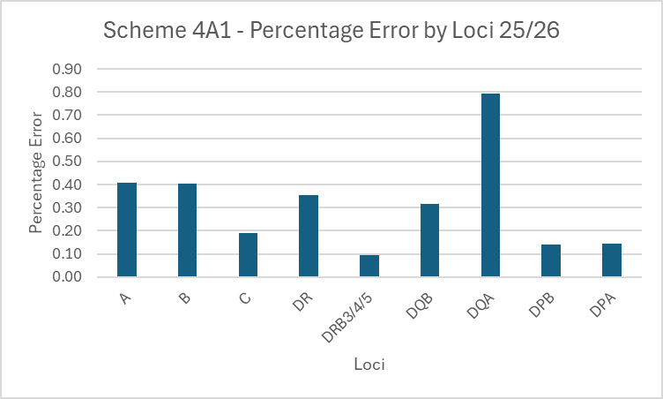
Scheme 4A1: 2025-26 Incorrect Assignments
40/11923 (0.34%) errors reported by 15 different labs (0 UK&I) – last year 0.12%
21 HLA types contained an error:
9 missed assignment (reported homozygous when heterozygous)
4 samples with the wrong genotype reported
3 samples with incorrect assignments e.g. A*68 rather than A*24
3 samples with no results submitted
1 reporting error (DQB results switched with DQA)
1 samples with DRB3/4/5 presence/absence reported incorrectly
12 (57%) HLA types with one error
9 (43%) HLA types with multiple errors
11 (73%) labs made 1 error
2 (13%) labs made 2 errors
2 (13%) lab made 3 errors
Notes:
<0.5% error rate when look at error by allele
15 labs (0 UK&I) made at least 1 error
21 HLA types had one error, 9 had multiple errors
Range of errors – most common was reporting homozygous instead of heterozygous
11 labs had 1 error, 4 had multiple errors
Majority of errors at DQA this year, historically DPB more common

Slide 57
Scheme 4A1: Unacceptable Performers 2025
Lab | Sample | Error | CAPA Response
133 | 09+10 | ? sample mix up | Transcription error
213 | 08-10 | No results submitted | No response
1412 | 05+10 | DQA1* and DQB1* missed assignments | Transcription error / reporting errors
1446 | 02+04 | A* and DQA1* incorrect assignments | No response
Notes:
4 labs with UP
2 no response
2 had transcription errors

Slide 58
4A1i
Interpretive HLA Genotype
Scheme

Slide 59
Scheme 4A1: Interpretive HLA Genotype
Purpose
Assess participants ability to correctly interpret their 4A1 genotype result to the ‘split’ specificity level.
At least 75% agreement on each specificity. When consensus is not met, a reference result is used.
Consensus
Satisfactory Performance
9 or more full HLA types in agreement with consensus/reference result in a distribution year.
10 HLA genotypes from Scheme 4A1

Slide 60
Scheme 4A1i: Performance
1 lab with unsatisfactory performance (0 UK&I)
 | 2019 | 2020 | 2021 | 2022 | 2023 | 2024 | 2025
Number of Participants (UK&I) | 44 (22) | 44 (22) | 42 (21) | 40 (21) | 40 (21) | 41 (20) | 42 (20)
Number with Unsatisfactory Performance (< 90%) (UK&I) | 8 (1) | 6 (2) | 5 (1) | 2 (0) | 1 (0) | 5 (0) | 1 (0)
% Unsatisfactory Performance | 18.1% | 13.6% | 11.9% | 5.0% | 2.5% | 12.2% | 2.4%
Notes:
Slight increase in numbers
1 UP, no UK&I
Decrease UP level compared to last year

Slide 61
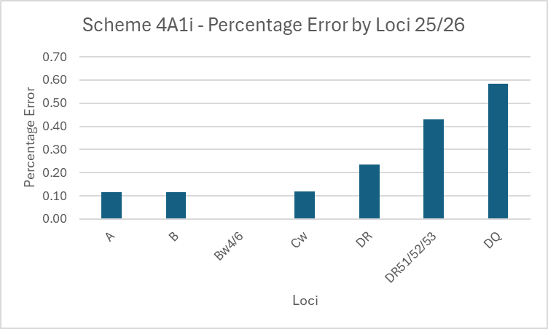
Scheme 4A1i: 2025-26 Incorrect Assignments
14/5874 (0.24%) incorrect results reported by 8 different labs (2 UK&I) – last year 0.22%
11 phenotypes contained an error:
2 samples with missing assignment (reported homozygous when heterozygous)
3 samples with errors at presence/absence of DR51/52/53 (2 UK)
3 reporting at broad not split specificity level
3 samples with incorrect assignments
7 (88%) labs made 1 error
1 (12%) lab made 4 errors
9 (81%) HLA types with single errors
2 (18%) HLA types with multiple errors
Notes:
<0.25% error rate when look at error by antigen
8 labs (2 UK&I) made at least 1 error
7 labs made 1 error, 1 labs made multiple errors
Majority of errors at DQ
11 HLA types had single errors, 2 had multiple error
Errors due to reporting at broad rather than split level spec, incorrect assignments, reporting homo rather than hetero and reporting the presence / absence of DR51/52/53 incorrectly

Slide 62
Scheme 4A1i: Unacceptable Performers 2025
Lab | Sample | Error | CAPA Response
1418 | 03,04,05+10 | Broads instead of splits/multiple reporting errors | No response
Notes:
No CAPA response from UP lab (note lab 1418 is a lab new to H&I)

Slide 63
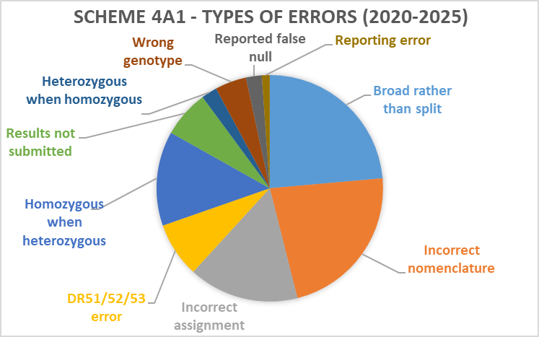
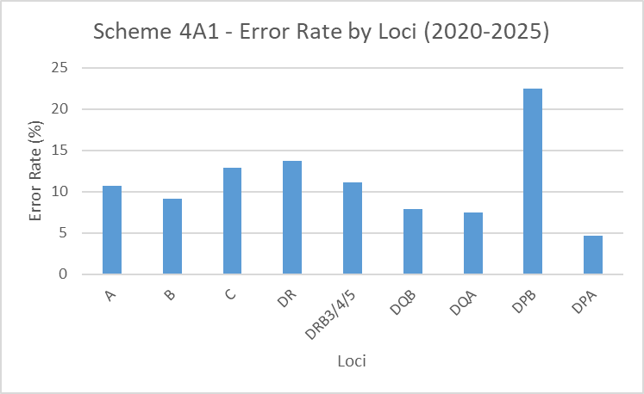
Scheme 4A1: Types of Errors 2020-2025
Notes:
If we look at the scheme as a whole over the past 5 years the majority of errors have occurred at HLA-DPB
errors are often caused by reporting at the broad rather than split spec level or using the incorrect nomenclature.

Slide 64
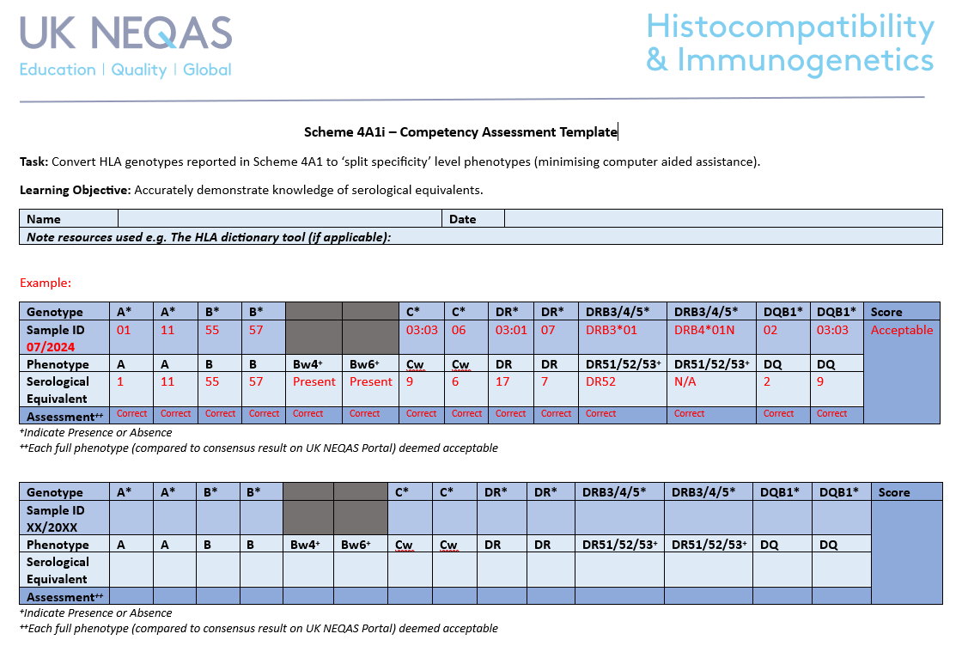
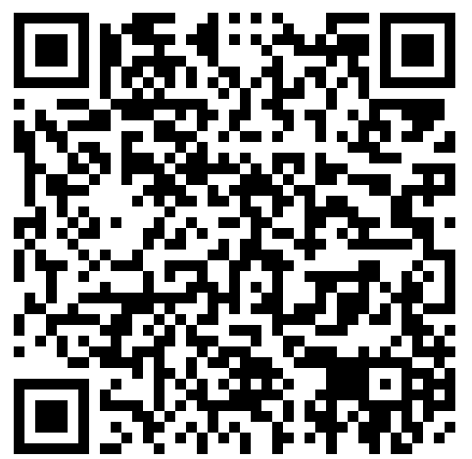
Scheme 4A1i: Serological Equivalents
4A1i Interpretative HLA Genotyping, which allows participants to translate genotypes to phenotypes
Participants are expected to report to the ‘split’ specificity level using serological nomenclature, e.g. HLA-DQB1*03:01 should be reported as DQ7 (DQ3)
Knowledge and exposure of phenotyping and converting between genotypes and phenotypes may no longer be so commonplace
Reliance on LIMS/analysis software
No longer perform phenotyping
Errors common due to reporting issues (broad rather split or using incorrect nomenclature)
CAPA repeatedly cite issues due to staff training and knowledge
Encourage utilisation of 4A1i for competency assessment
UK NEQAS have developed a template:
https://ukneqashandi.org.uk/app/uploads/2025/03/Scheme-4A1i-Template.docx
Notes:
In order to help address some of these errors we are encouraging labs to properly utilise scheme 4A1i.

Slide 65
4A2
DNA Typing to 2nd or 3rd Field Resolution
Scheme

Slide 66
Scheme 4A2: DNA Typing to 2nd or 3rd Field Resolution
Purpose
Assess participants ability to correctly determine HLA type to 2nd or 3rd field.
Consensus
At least 75% agreement on each allele. If consensus is not met, a reference result is used.
Satisfactory Performance
9 or more full HLA types in agreement with consensus/reference genotype in a distribution year.
10 blood samples over 3 distributions

Slide 67
Scheme 4A2: Performance
41/63 participants registered for 2nd field
21/63 participants registered for 3rd field
5 labs with unsatisfactory performance (0 UK&I)
 | 2019 | 2020 | 2021 | 2022 | 2023 | 2024 | 2025
Number of Participants (UK&I) | 62 (20) | 64 (20) | 63 (22) | 61 (23) | 65 (23) | 67 (23) | 63 (23)
Number with Unsatisfactory Performance (< 90%) (UK&I) | 9 (1) | 7 (0) | 6 (0) | 4 (0) | 9 (2) | 8 (1) | 5 (0)
% Unsatisfactory Performance | 14.5% | 11.0% | 11.1% | 6.5% | 13.8% (8.7%) | 11.9% (4.3%) | 7.9%
Notes:
Decrease in numbers
41/63 2nd field
21/63 3rd field
5 labs with PP, 0 from UK&I
UP level lower than last year

Slide 68
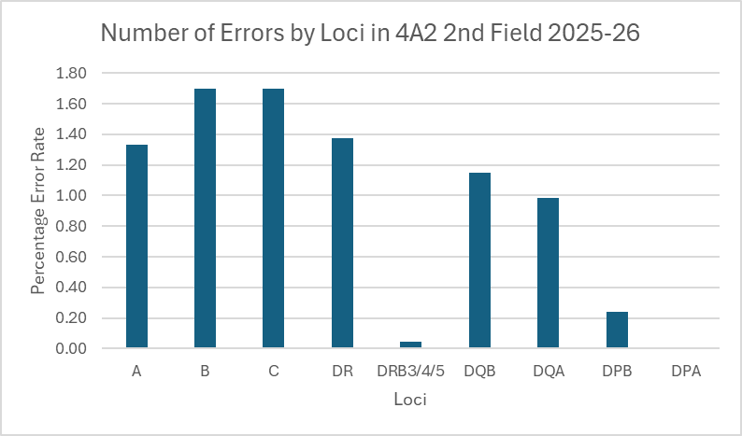
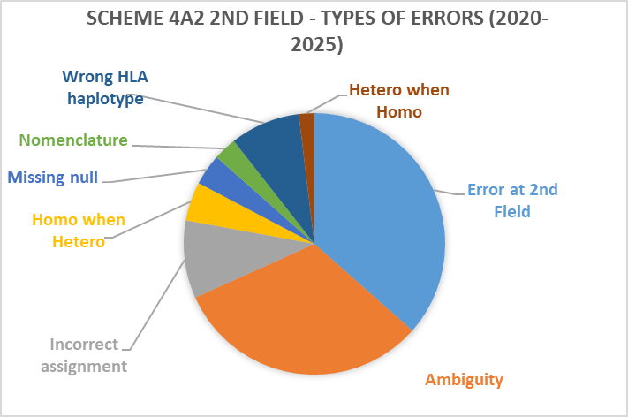
Scheme 4A2: Incorrect Assignments: 2nd Field
71/8530 (0.83%) incorrect HLA alleles reported by 4 labs (0 UK&I) – last year (0.79%)
1 incorrect assignment
3 reports of errors at the 2nd field
e.g. DQA1*03:02 rather than DQA1*03:03
7 reports of the wrong HLA type
2 (50%) labs made 1 error
1 (25%) lab made 2 errors
1 (25%) lab made 7 errors
3 (27%) HLA types with a single error
8 (73%) HLA types with multiple errors
Notes:
2nd Field
<1.0% error rate
4 labs (0 UK&I) made at least 1 error
7 labs made 1 error, 5 had multiple errors
Majority of errors at DP
6 HLA type had multiple errors, 17 had only 1 error
Range of errors – most common was making an error at the second field then failing to resolving ambiguities

Slide 69
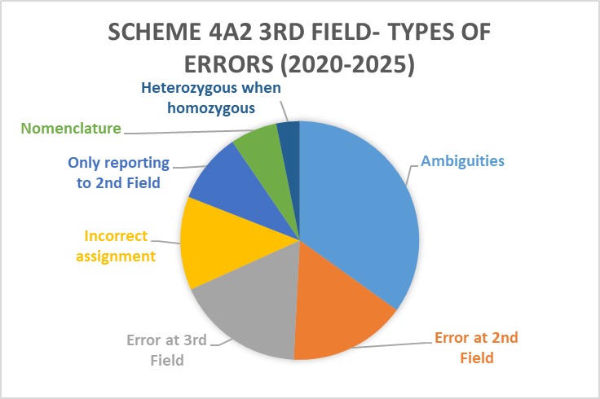
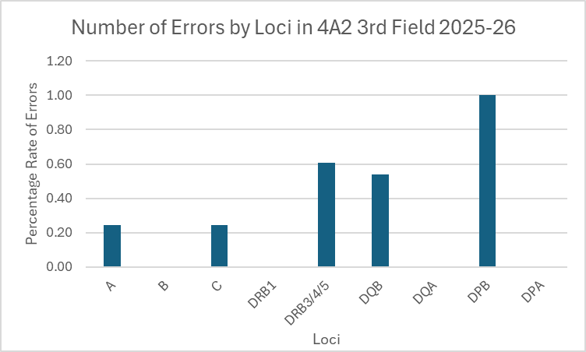
Scheme 4A2: Incorrect Assignments: 3rd Field
11/3420 (0.32%) incorrect HLA alleles reported by 5 labs (0 UK&I) – last year (0.32%)
3 errors at 3rd field e.g. DPB1*03:01:03 rather than DPB1*03:01:01
2 reported homozygosity but actually heterozygous
1 error at 2nd field e.g. C*03:03:01 rather than 03:321:XX
1 reported heterozygous but actually homozygous
1 3rd field not reported
1 (11%) HLA types with multiple errors
8 (89%) HLA types with a single error
3 (60%) labs made 1 error
1 (20%) lab made 2 errors
1 (20%) lab made 3 errors
Notes:
3rd Field
<1.0% error rate when look at error by allele
5 labs (0 UK&I) made at least 1 error
3 labs made 1 error, 2 labs made multiple errors
Majority of errors at DPB
1 HLA type had multiple errors, 8 had only 1 error
Range of errors – most common was making an error at the third field, reporting homozygous instead of heterozygous, making an error at 2nd field, reporting heterozygous rather than homozygous or not reporting to 3rd field level

Slide 70
Scheme 4A2: Unacceptable Performers 2025
Lab | Sample | Error | Field | CAPA Response
112 | 04-10 | Incorrect HLA types reported | 2nd | Incorrect results reported, mix-up of results, no second check
133 | 04+06 | 4A2 04/2025: Reported DPB1*04:01:01, 1321:01, consensus DPB1*04:01:01, 04:01:01 4A2 06/2025: Reported DPB1*04:01:01, 1321:01, consensus DPB1*04:01:01, 04:01:01 | 3rd | Reporting error
361 | 03+07 | 4A2 03/2025: Reported A*01:03, 03:01, consensus A*01:01, 03:01 4A2 07/2025: Reported B*27:03, 44:02, consensus B*27:05, 44:02 | 2nd | Kit resolution / interpretation issue
268 | 02+08 | 4A2 02/2025: Reported DRB4*01:01, consensus DRB4*01:01:01 4A2 08/2025: Reported DRB3*01:01:01, consensus DRB3*01:01:02 | 3rd | Transcription / reporting errors
1411 | 01, 08+09 | 4A2 01/2025: Reported DPB1*04:01:01, 105:01:01, consensus DPB1*04:01:01, 04:01:01 4A2 08/2025: Reported C*07:01:01, 07:01:01, consensus C*07:01:01, 07:01:02 4A2 09/2025: Reported DQB1*02:01:01, 03:02:02, consensus DQB1*02:01:01, 03:02:01 | 3rd | Transcription / interpretation errors
Notes:
5 CAPA responses completed
Mostly clerical errors – transcription or reporting errors but some kit resolution issues and a sample mix up noted

Slide 71
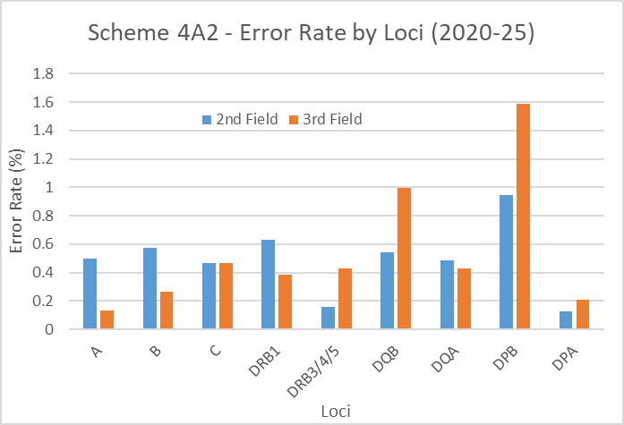
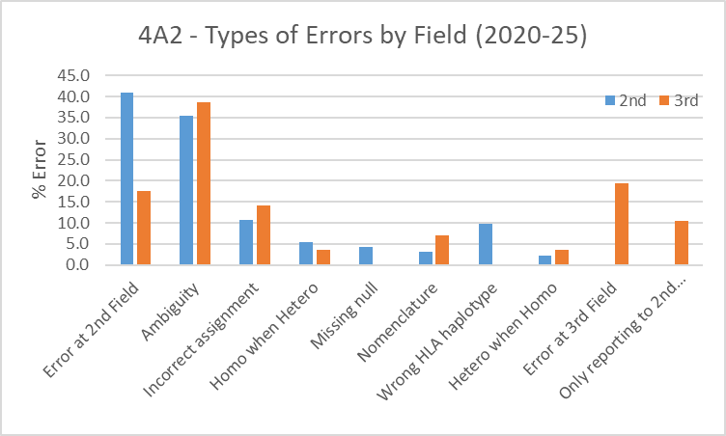
Scheme 4A2: Summary of Errors 2020-2025
Notes:
When we look at the past 5 years worth of data across 2nd and 3rd field we can see that the majority of errors occur at HLA-DPB
In terms of the types of errors reporting amb and making errors at the second field are the most common errors made.

Slide 72
9
KIR Genotyping
Scheme

Slide 73
Scheme 9: KIR Genotyping
Purpose
Assess participants ability to correctly determine the presence or absence of specific KIR genes.
Consensus
At least 75% agreement on the presence/abesence of each gene. Reference type used where consensus is not met
Satisfactory Performance
9 or more full KIR genotypes in agreement with consensus/reference genotype in a distribution year.
10 blood samples over 2 distributions

Slide 74
Scheme 9: KIR Genotyping
Participants able to report any of the following: KIR2DL1, KIR2DL2, KIR2DL3, KIR2DL4, KIR2DL5, KIR3DL1, KIR3DL2, KIR3DL3, KIR3DS1, KIR2DS1, KIR2DS2, KIR2DS3, KIR2DS4, KIR2DS5, KIR2DP1, KIR3DP1.
Also able to report any other KIR polymorphisms they detected for information
Participants can also report an ‘A’ or ‘B’ haplotype for each sample based on the gene content of the sample

Slide 75
Scheme 9: Performance
0 lab with unsatisfactory performance
 | 2019 | 2020 | 2021 | 2022 | 2023 | 2024 | 2025
Number of Participants (UK&I) | 12 (1) | 12 (1) | 15 (1) | 15 (1) | 15 (1) | 13 (1) | 13 (1)
Number with Unsatisfactory Performance (UK&I) | 3 (0) | 0 (0) | 1 (0) | 0 (0) | 1 (0) | 1 (0) | 0 (0)
% Unsatisfactory Performance | 25% | 0% | 6.7% | 0% | 6.7% | 7.7% | 0%
Notes:
Stable numbers
0 UP

Slide 76
Scheme 9: Unacceptable Performers 2025
Lab | Polymorphism | Error | CAPA Response
N/A | N/A | N/A | N/A
Notes:
CAPA response stated Interpretation error due to staff training with interpreting results

Slide 77
10
HPA Genotyping
Scheme

Slide 78
Scheme 10: HPA Genotyping
Purpose
Assess participants ability to correctly determine HPA polymorphisms.
Consensus
At least 75% agreement on the presence/abesence of each allele. Reference type used where consensus is not met
Satisfactory Performance
9 or more full HPA types in agreement with consensus/reference genotype in a distribution year.
10 blood samples over 2 distributions

Slide 79
Scheme 10: HPA Genotyping
Participants able to report any of the following: HPA‐1, HPA‐2, HPA‐3, HPA‐4, HPA‐5, HPA‐6, HPA‐15
- 35/38 reported HPA-1, 2 , 3, 4, 5 and 15
- 30/38 labs reported HPA-6
Also able to report any other HPA polymorphisms detected, for information

Slide 80
Scheme 10: HPA Genotyping
1 lab with unsatisfactory performance
 | 2018 | 2019 | 2020 | 2021 | 2022 | 2023 | 2024 | 2025
Number of Participants (UK&I) | 37 (6) | 38 (6) | 40 (0) | 38 (6) | 39 (6) | 39 (6) | 38 (6) | 38 (6)
Number with Unsatisfactory Performance (< 100%) (UK&I) | 1 (0) | 3 (0) | 0 (0) | 0 (0) | 1 (0) | 1 (0) | 0 (0) | 1 (0)
% Unsatisfactory Performance | 2.7% | 7.9% | 0% | 0% | 2.6% | 2.6% | 0% | 2.6%
Notes:
Consistent numbers in scheme
1 UP

Slide 81
Scheme 10: Unacceptable Performers 2025
Lab | Error | CAPA Response
382 | 10 09/2025: False Pos HPA 3b 10 10/2025: False Neg HPA 3b | labelling error/sample mix up
Notes:
CAPA response stated Interpretation error due to staff training with interpreting results

Slide 82
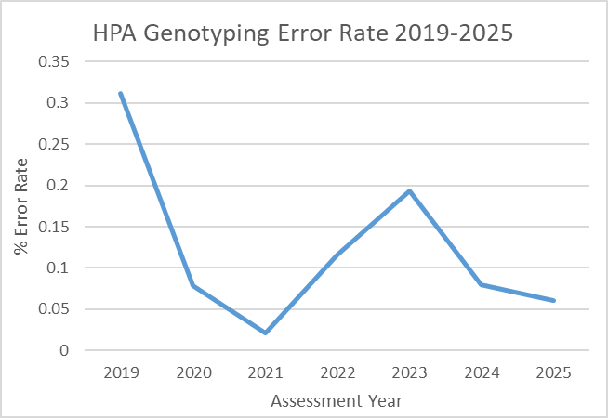
Scheme 10: Errors in HPA Genotypes 2025
Error rate extremely low 0.06% but errors at some clinically relevant polymorphisms
Errors found at HPA-3b (n=2), HPA-5a (n=1)
Even split of false positive (n=1) and false negative (n=2) errors
2 labs made an error (1 lab made 1 error, 1 lab made 2 errors)
Notes:
Analysis of errors over past year
Very low error rate 0.06%, consistently low over last 6 years
Errors often at clinically relevant p/m e.g. 3b, 5a
2 false neg v 1 false pos result
2 labs made errors : one made 1 error, one made 2 errors

Slide 83
1B
HLA-B27 Testing
Scheme

Slide 84
Scheme 1B: HLA-B27 Testing
Purpose
Assess participants ability to correctly determine HLA-B27/2708/B*27 status.
Consensus
At least 75% agreement on B27 status. Reference type used where consensus is not met
Satisfactory Performance
Making 10/10 reports that are in agreement with consensus in a distribution year.
10 blood samples sent over 5 distributions

Slide 85
Scheme 1B: Performance
10 labs with unsatisfactory performance (4 UK&I)
 | 2019 | 2020 | 2021 | 2022 | 2023 | 2024 | 2025
Number of Participants (UK&I) | 133 (53) | 141 (52) | 141 (50) | 139 (49) | 134 (50) | 131 (49) | 125 (48)
Number with Unsatisfactory Performance (< 100%) (UK&I) | 4 (1) | 12 (2) | 3 (0) | 8 (0) | 11 (3) | 16 (3) | 10 (4)
% Unsatisfactory Performance (UK&I) | 3.0% (1.9%) | 8.5% (3.8%) | 2.1% (0%) | 5.7% (0%) | 8.2% (6%) | 12.2% (6%) | 8% (8%)
4/10 samples distributed were HLA-B27 positive
Notes:
Reduction in participant numbers
Decrease of UP to 10, 4 from UK&I

Slide 86
Scheme 1B: 2025 Incorrect Assignments
Sample | Result | Lab Number | Technique | HLA Type | Lab Identified Cause
1B 05 | False neg | 1435 | Unknown | B27 B44 | No response
1B 05 & 06 | False pos / false neg No results | 130 324 | Molecular Serological | B27 B44 B7 B8 | Sample mix up No response
1B 06 | False pos | 55 | Molecular | B7 B8 | Reporting error
1B 07 & 08 | False pos / false neg No results | 31 334 | Serological Uknown | B7 B39 B27 B51 | Sample mix up No response
1B 08 | False neg | 8 40 256 372 | Serological Uknown Serological Serological | B27 B51 | Technical / reagent issue Incorrect storage, poor sample prep Delivery delay/storage issues/poor sample Delay to testing, poor sample prep
1B 09 & 10 | No results | 334 | Uknown | B7 B8 B8 B35 | No response
7/10 labs with unsatisfactory performance completed CAPA
70% false negative, 30% false positive
70% errors involved serological techniques
Overall participants use: 78% use molecular methods, 22% use serological methods

Slide 87
5A
HFE Typing
Scheme

Slide 88
Scheme 5A: HFE Testing
Purpose
Assess participants ability to correctly determine HFE mutations.
3 mutations assessed:
Codon 63: Histidine63Aspartic acid (H63D)
Codon 282: cysteine282tyrosine (C282Y)
Codon 65: Serine63Cysteine (S65C)
Consensus
At least 75% agreement on each HFE mutation. Reference type used where consensus is not met
Satisfactory Performance
10 reports in agreement with consensus/reference result in a distribution year.
10 donor samples sent over 3 distributions

Slide 89
Scheme 5A: Performance
3 labs with unsatisfactory performance (2 UK&I)
 | 2019 | 2020 | 2021 | 2022 | 2023 | 2024 | 2025
Number of Participants (UK&I) | 51 (38) | 49 (36) | 45 (32) | 37 (27) | 38 (26) | 37 (25) | 33 (22)
Number with Unsatisfactory Performance (< 100%) (UK&I) | 2 (1) | 1 (1) | 1 (1) | 4 (3) | 1 (1) | 3 (1) | 3 (2)
% Unsatisfactory Performance | 3.9% (2.6%) | 2.0% (2.8%) | 2.2% (3.1%) | 10.8% (11.1%) | 2.6% (3.8%) | 8.1% (4%) | 9.1% (9.1%)
CAPA responses (n=1/3)
Sample mix up – 33.3%
No reply – 66.6%

Slide 90
5B
Interpretive HFE genotype and Hereditary Haemochromatosis
Scheme

Slide 91
Scheme 5B: Interpretive HFE genotype and Hereditary Haemochromatosis
Purpose
Assess participants ability to produce an accurate, clear and concise clinical report. HFE genotype and various clinical information provided
Assessment
Reports must be identical in format to those typically produced by lab. Penalty points awarded for failure to cover interpretive criteria identified and agreed by the expert assessors.
Satisfactory Performance
Must have <50% of available penalty points available to be considered acceptable.
Twice a year, 2 clinical scenarios

Slide 92
Scheme 5B: Performance
0 labs with unsatisfactory performance (0 UK&I)
 | 2019 | 2020 | 2021 | 2022 | 2023 | 2024 | 2025
Number of Participants (UK&I) | 21 (17) | 19 (15) | 16 (12) | 15 (11) | 12 (10) | 9 (8) | 7 (6)
Number with Unsatisfactory Performance (UK&I) | 3 (1) | 1 (0) | 0 (0) | 2 (1) | 0 (0) | 0 (0) | 0 (0)
% Unsatisfactory Performance | 14% | 5.3% | 0% | 13% | 0% | 0% | 0%

Slide 93
Scheme 5B: Performance
2025 – All 4 scenarios:
maximum 6 penalty points per scenario, 24 in total.
6 labs got 0-1 penalty points
1 got 1.5-2 penalty points
1 got 2.5-3 penalty point
0 got 3.5-4 penalty points
0 got 4.5-5 penalty points
0 got >12 penalty points

Slide 94
7
HLA-related Pharmacogenetics
Scheme

Slide 95
Scheme 7: HLA-related Pharmacogenetics
Assess participants ability to correctly determine relevant HLA types for the drugs specified: Allopurinol, Carbamazepine, Oxcarbazepine, Lamotrigine, Flucloxacillin, Phenytoin & Tebentafusp
Purpose
Consensus
At least 75% agreement on the status of HLA type. Reference result used when consensus not met.
Satisfactory Performance
Making 10 sample reports in agreement with the consensus/reference result in a distribution year.
10 blood samples over 3 distributions

Slide 96
Scheme 7: Performance
1 lab with unacceptable performance
 | 2019 | 2020 | 2021 | 2022 | 2023 | 2024 | 2025
Number of Participants (UK&I) | 67 (27) | 67 (27) | 64 (25) | 52 (18) | 50 (18) | 46 (18) | 48 (18)
Number with Unacceptable Performance (< 100%) (UK&I) | 0 (0) | 2 (0) | 1 (1) | 3 (0) | 2 (0) | 1 (0) | 1 (0)
% Unsatisfactory Performance | 0.0% | 3.1% | 1.6% | 5.8% | 4.0% | 2.2% | 2.1%
6/10 samples distributed were HLA-A*02:01 positive
3/10 samples distributed were HLA-A*31:01 positive
5/10 samples distributed were HLA-B*57:01 positive
2/10 samples distributed were HLA-B*58:01 positive
1/10 samples distributed were HLA-B*15:02 positive
Notes:
Increase in particpants from last year
1 UP
Samples overed a full range of HLA types applicable to the drugs offered in the scheme

Slide 97
Scheme 7: Unacceptable Performers 2025
Lab | Sample | Error | CAPA Response
413 | 08 | Abacavir B*57:01 - False neg | Misinterpretation of results due to method used

Slide 98
8
HLA Genotyping for Coeliac and other HLA Associated Disease
Scheme

Slide 99
Scheme 8: HLA Genotyping for Coeliac and other HLA Associated Disease.
Purpose
Assess participants ability to correctly determine HLA type associated with various diseases e.g. coeliac disease, narcolepsy.
Assessment
Lab results reported in format identical to clinical report. Reference HLA result used for assesment.
Satisfactory Performance
Making 10 sample reports in agreement with the reference genotype in a distribution year.
10 blood samples over 3 distributions

Slide 100

Scheme 8: Performance
17 Unsatisfactory Performers (2 UK&I)
 | 2019 | 2020 | 2021 | 2022 | 2023 | 2024 | 2025
Number of Participants (UK&I) | 50 (11) | 55 (12) | 55 (10) | 54 (11) | 57 (11) | 55 (11) | 53 (11)
Number with Unsatisfactory Performance (< 100%) (UK&I) | 13 (2) | 17 (5) | 12 (2) | 25 (5) | 18 (2) | 10 (1) | 17 (2)
% Unsatisfactory Performance | 26% (18%) | 31% (42%) | 22% (20%) | 46.3% (45%) | 31.6% (18%) | 18.2% (9.1%) | 32.1% (18.2%)
CAPA responses (n=13/17)
Kit interpretation error – 38%
Transcription errors – 31%
Procedural error – 23%
Reporting error – 8%
Notes:
Level of UP increased again following decrease last year
Mostly due to CD
13/17 labs submitted CAPA response
kit issues, transcription errors, reporting and procedural errors noted
Note that the 2 Uk labs reported technical and reporting issues

Slide 101
Scheme 8: Unacceptable Performance by Disease
Disease | HLA Association | Number of Participants | No. of Participants with Unacceptable Performance
Coeliac | DQ2.5, DQ8, DQ2.2 | 50 | 16 (32%)
Narcolepsy | DQB1*06:02 | 23 | 0
Actinic Prurigo | DRB1*04:07 | 5 | 1 (20%)
Birdshot Retinopathy | A*29 | 13 | 0
Behçet's | B*51 | 20 | 1 (5%)
Rheumatoid Arthritis | DRB1*04 | 5 | 2 (40%)
Diabetes | DR3, DR4 | 8 | 1 (12.5%)
Psoriasis | C*06 | 5 | 0
Notes:
Look at breakdown by disease
% poor performance is high in certain diseases like RA and Diabetes but this is an artefact of small participant numbers.
Performance in CD is still a cause for concern.

Slide 102
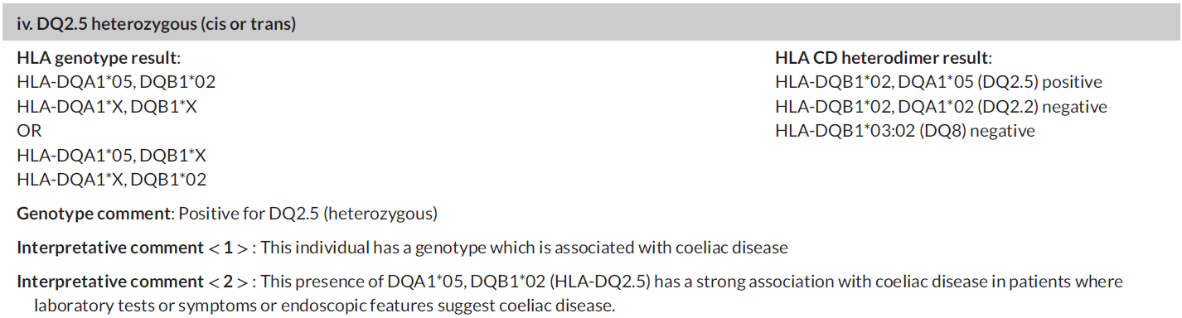

Scheme 8: Interpretative Comments
Interpretation of the genotype in terms of predisposition to CD not currently assessed
A pilot to establish a scoring system for assessment is underway
Pritchard D, Anand A, De'Ath A, Lee H, Rees MT. UK NEQAS and BSHI guideline: Laboratory testing and clinical interpretation of HLA genotyping results supporting the diagnosis of coeliac disease. Int J Immunogenet. 2024 Jan;51 Suppl 1:3-20. doi: 10.1111/iji.12649. Epub 2023 Dec 28. PMID: 38153308.
Notes:
Published guidelines – QR link on screen to paper
Establishing scoring for assessment of interpretative comments

Slide 103
Performance Summary for all Schemes
Scheme Summary

Slide 104
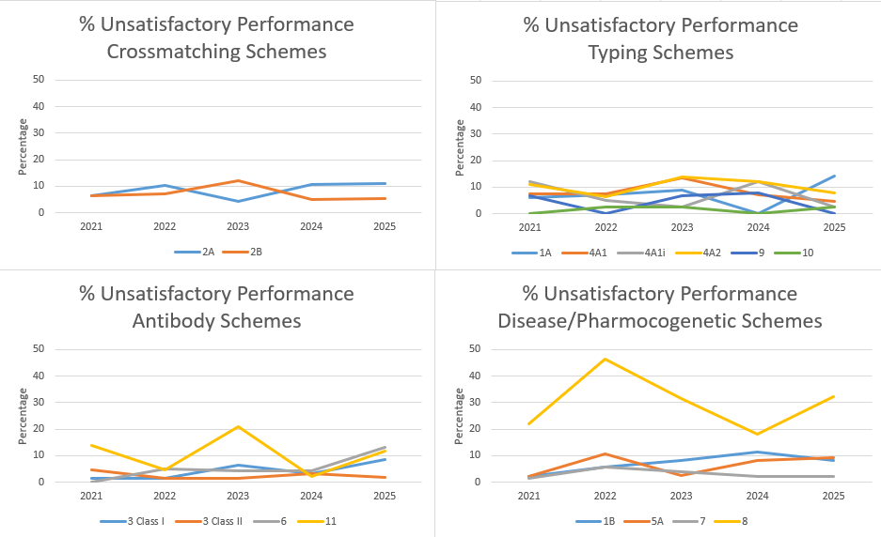
5 Year Trends in Unsatisfactory Performance
Notes:
Many schemes were consistent with previous years or had a slight increase
"L:\Persistent Poor Performance\NEQAS 5 year UP rates.xlsx"

Slide 105
Thanks!
Do you have any questions?
UKNEQASHandI@Wales.NHS.UK
+44(0)1443 622185
www.ukneqashandi.org.uk

Slide 106
UK NEQAS for H&I Educational Crossmatch Scenario (EDXM) Amy De’Ath UK NEQAS for H&I Manager

Slide 107


“”
“Schemes should relate more closely to clinical scenarios rather than testing individual test assays.”
Notes:
schemes do not portray real clinical testing in a H&I lab.
discuss at our SC - how we can achieve this whilst working within the confines of an EQA programme.

Slide 108

Whole Process ‘EQA’
Educational Schemes
Assessed Schemes
Educational HLA Typing (ED) – 4 samples
Interpretative Educational Scenarios (iED) – 3 scenarios
Educational Crossmatch Scheme (EDXM)
Clinical decision making based on results from multiple assays
Each assay only gives part of the picture
Results from one assay can influence the interpretation of another
Variation between centres (repertoires, cut-offs)
EDXM mirrors:
1A, 4A1, 4A2 – HLA Typing
6 – HLA Antibody Detection
3 – HLA Antibody Specification
2A, 2B – Crossmatching
Notes:
We offer free educational schemes alongside our traditional assessed ones.
Educational schemes are not assessed and allow us greater flexibility to send unusual samples.
Two of our most popular educational schemes are iED scenarios and EDXM
These mirror lab practice more closely
interpretation of results is based on results from multiple assays

Slide 109

Educational Scheme Distribution
Educational Scheme Distribution
‘Donor’ Sample
HLA Typing
(Schemes 4A1 & 4A2)
Crossmatching
(Schemes 2A & 2B)
‘Patient’ Samples
3 x Serum Samples
Antibody Detection / Specification
(Schemes 3 & 6)
Clinical Interpretation
Transplant Risk Stratification
Notes:
EDXM = Donor sample and 3 patient samples
donor HLA typing, antibody testing on patient samples and crossmatching.
clinical interpretation and risk stratification.

Slide 110

2025 Submissions
32 participants submitted results
Not all labs reported results for all tests
HLA genotype:
Consensus HLA Type | A* | B* | C* | DRB1* | DRB3* | DRB5* | DQA1* | DQB1* | DPA1* | DPB1*
 | 03:01 | 07:02 | 07:02 | 13:01 | 01:01 | 01:01 | 01:02 | 06:02 | 01:03 | 02:01
 | 03:01 | 15:18 | 07:04 | 15:01 |  |  | 01:03 | 06:03 | 01:03 | 04:01
Number of reports | 32 | 32 | 32 | 32 | 26 | 25 | 29 | 32 | 25 | 30
% Labs in consensus | 100% | 100% | 100% | 100% | 100% | 100% | 100% | 100% | 100% | 100%
34% (n=11/32) of participants reported a phenotype or at the first field only
50% (n=16/32) reported to the 2nd field
16% (n=5/32) reported to the 3rd field
Notes:
In 2025 32 participants in EDXM
100% consensus in genotype

Slide 111
Serum 1
01
Results
Notes:
So for patient number 1

Slide 112
Serum 1 Results
 | Result | % Consensus | Comments
HLA Class I Antibodies | Positive | 100% (32/32)
HLA Class II Antibodies | Positive | 100% (32/32)
DSA | Present | 100% (31/31) | MFI >20,000 for CI and CII
CDC XM | PBL Positive T cell No Consensus B cell Positive | 100% (2/2) 70% (7/10 Pos) 100% (8/8)
FCXM T Cell | Positive | 100% (27/27)
FCXM B Cell | Positive | 100% (25/2)
Transplant Risk | High/Contraindication | 100% (31/31)
Immunological Advice | Not suitable for direct transplantation. High risk of hyperacute rejection.
Recommendations | Seek alternative donor. Consider de-sensitisation (assess with dilution testing). Discuss risk with patient.
Notes:
CI and CII ab present
100% presence of DSA some reaching over 20,000 for CI and CII DSA
CDCXM predominantly positive (although no consensus for T cell CDCXM)
Positive by FCXM
100% stated high risk
All labs stated that transplantation is not suitable for direct transplantation with a risk of hyperacute rej.
Recommendation to seek alternative donor, consider desensitisation and discuss the risk with patient

Slide 113
Serum 2
02
Results

Slide 114
Serum 2 Results
 | Result | % Consensus | Comments
HLA Class I Antibodies | Positive | 97% (31/32)
HLA Class II Antibodies | Positive | 97% (31/32)
DSA | Present | 100% (31/31) | CI MFI <10,000; CII MFI <15,000
CDC XM | PBL Negative T cell Negative B cell Negative | 100% (2/2) 100% (10/10) 87.5% (7/8) | CDCXM Negative FCXM Positive
FCXM T Cell | Positive | 78% (21/27)
FCXM B Cell | Positive | 88% (22/25)
Transplant Risk | Intermediate High/Contraindication | 19% (6/31) 81% (25/31)
Immunological Advice | Not suitable for direct transplantation. High risk of AMR. If transplant proceeds use enhanced immunosuppression and post-transplant monitoring. Test for non-HLA and autologous antibodies.
Recommendations | Seek alternative donor. Consider de-sensitisation. Monitor antibodies over time to consider de-listing. Discuss risk with patient.
Notes:
Agreement that CI and CII ab are present in this sample
100% agreement on presence of DSA: lvels for class I were generally below 10,000 and for class II below 15,000
XM result the sample was deemed negative for CDCXM
FCXM consensus positive
Disagreement on risk rating: 19% intermediate risk while 81% stated high or contraindication
Most stated that this donor and recipient combination were not suitable for direct tx due to a high risk of AMR. Some noted that if transplant proceeds use enhanced immunosuppression and post-transplant monitoring. Some would also Test for non-HLA and autologous antibodies.
Most would recommend finding an alternative donor or consider delisting or desensitisation and to discuss risk with the patient.

Slide 115
Serum 3
03
Results
Notes:
So for the final patient and donor combination

Slide 116
Serum 3 Results
 | Result | % Consensus | Comments
HLA Class I Antibodies | Not Assessed | 62.5% Pos (20/32)
HLA Class II Antibodies | Negative | 78% (25/32)
DSA | None | 93.5% (29/31) | Two labs reported CI and CII DSA <5,000 MFI
CDC XM | PBL Negative T cell Negative B cell Negative | 100% (2/2) 100% (10/10) 100% (8/8)
FCXM T Cell | Negative | 100% (27/27)
FCXM B Cell | Negative | 100% (25/25)
Transplant Risk | Low/Standard Medium High/Contraindication | 94% (29/31) 3% (1/31) 3% (1/31)
Immunological Advice | Suitable for direct transplantation. HLA antibody present but not donor directed.
Recommendations | Proceed to transplant. Standard immunosuppression and post-transplant monitoring. Post-transplant monitoring if clinical indication of rejection.
Notes:
62.5% reported that Class I antibodies were present which didn’t meet 75% consensus rate
CII antibodies were consensus negative in this sample
Majority of labs reported that there was no DSA present but there was 2 exceptions
All labs reported CDCXM neg
All labs reported FCXM neg
Lab agreed that this situation was suitable for direct transplant and the transplant could proceed using standard protocols

Slide 117

UK NEQAS for H&I Comments
The same sample was used for both Serum 1 and Serum 2.
The sample was provided at neat for Serum 1 and at a dilution of 1:16 for Serum 2.
All antibodies reduced in MFI value upon dilution.
 | Serum 1 (neat) | Serum 2 (1:16)
Consensus DSA | A3, B7, DR13, DR15 and DR52 | A3, B7, DR13 and DR52
MFI range of DSA | 965-31,318 | 628-12,133
Contraindication to Tx | 100% | 81%
Notes:
In a little plot twist we actually used the same sample for both Serum 1 and Serum 2.
The sample was provided at neat for Serum 1 and at a dilution of 1:16 for Serum 2.
All antibodies reduced in MFI value upon dilution.
The DSA reaching consensus present in Serum 2 (1:16 dilution) were A3, B7, DR13 and DR52 detected at a range of 628-12,133 MFI. 81% of participants noted this was a contraindication to transplantation. In contrast, in Serum 1 (neat) donor specific antibodies reaching consensus were A3, B7, DR13, DR15 and DR52 detected at a range of 965-31,318 MFI. 100% of participants noted this was a contraindication to transplantation.

Slide 118
Summary of Crossmatch and DSA Detection Results
2025 Results |  | Serum 1 NEAT |  | Serum 2 1:16 |  | Serum 3
DSA Defined by Luminex |  | Class I | Class II | Class I | Class II | Class I | Class II
MFI >20,000 |  | A3 (100%) B7 (100%) | DR13 (100%) DR52 (97%)
MFI 10,000 – 19,999 |  |  |  |  | DR52 (97%)
MFI 5,001-9,999 |  |  |  | B7 (100%) | DR13 (100%)
MFI 2,501-5,000 |  |  | DR15 (74%) | A3 (94%) |  |  | DR52 (3%) DR13 (3%)
MFI <2,500 |  |  | DQ6 (6%) DQA*01 (3%) DP2 (3%) DP4 (3%) |  |  | Cw7 (3%)
CDCXM B CELL | No DTT | Positive |  | Negative |  | Negative
 | DTT | Positive |  | Negative |  | Negative
FCXM | T Cell | Positive |  | Positive |  | Negative
 | B Cell | Positive |  | Positive |  | Negative
Risk |  | Contraindication (100%) |  | Medium (19%) High/Contraindication (81%) |  | Contraindication (3%) Medium (3%) Low/Standard (94%)
The table shows the percentage of participants identifying a DSA and the most common MFI range it was reported in.
Notes:
This rather complex table shows you a summary of DSAs and the MFI range they were mostly detect in for all three samples.
You can see the dilution effect from serum 1 at neat and serum 2 at 1:16 * where ab have decreased * MFI. CDCXM has changed to negative but FCXM remains pos.
In serum 3 you will note that some labs reported low level DSA but this did not translate to a positive XM
In general the huge differences in MFIs between laboratories which makes this find of direct comparison difficult.
differences in risk may be due to differing guidelines between regions or testing methods
Similarities in immunological advice offered.

Slide 119
Benefits
Benchmarking
Education
Competency
Monitor concordances Review variations Staff training
Laboratory staff Clinical staff
Monitor performance of multiple techniques Make clinical interpretations on own results Compare local policies for clinical assessment
Notes:
benefits of educational schemes
benchmarking against other participants,
educational remit and learning from others without the pressure of formal assessment
opportunity for competency assessment of staff.

Slide 120
Future Considerations
Formal Assessment
Complexity
Basis of future scheme design
How to assess the correct clinical interpretation
Participants
NEQAS team
Individual competency assessment
Any ideas?
Workload
Competency
Notes:
new ideas
EDXM formally assessed
workload for us and for you.
how to assess the scheme.
Replace other schemes
Would you like to see more offerings from us perhaps in terms of being able to provide a gateway for individual competency assessment?

Slide 121
Thanks!
Do you have any questions?
UKNEQASHandI@Wales.NHS.UK
+44(0)1443 622185
www.ukneqashandi.org.uk

